Slide 1
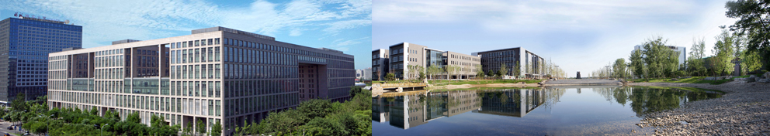
Design and Analysis of Algorithms
Part IV: Graph Algorithms
Lecture 11: Single-Source Shortest Paths
Ke Xu and Yongxin Tong
(许可 与 童咏昕)
School of CSE, Beihang University

Slide 2
Outline
Review to Part IV
Single-Source Shortest Paths Problem
Dijkstra’s Algorithm
The idea
The algorithm
Analysis of Dijkstra’s algorithm
The Bellman-Ford Algorithm
The algorithm
Analysis of Bellman-Ford algorithm

Slide 3
Outline
Review to Part IV
Single-Source Shortest Paths Problem
Dijkstra’s Algorithm
The idea
The algorithm
Analysis of Dijkstra’s algorithm
The Bellman-Ford Algorithm
The algorithm
Analysis of Bellman-Ford algorithm

Slide 4
Introduction to Part IV
In Part IV, we will illustrate several graph algorithm problems using several examples:
Basic Concepts of Graphs (图的基本概念)
Breadth-First Search [BFS] (广度优先搜索)
Depth-First Search [DFS] (深度优先搜索)
Topological Sort (拓扑排序)
Strongly Connected Components (强联通分量)
Minimum Spanning Trees (最小生成树)
Single-Source Shortest Paths (单源最短路径)
All-Pairs Shortest Paths (所有结点对的最短路径)
Maximum/Network Flows (最大流/网络流)

Slide 5
Outline
Review to Part IV
Single-Source Shortest Paths Problem
Dijkstra’s Algorithm
The idea
The algorithm
Analysis of Dijkstra’s algorithm
The Bellman-Ford Algorithm
The algorithm
Analysis of Bellman-Ford algorithm

Slide 6
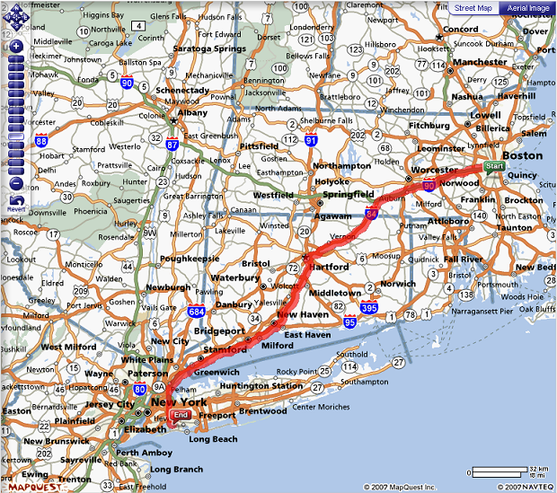
Single-Source Shortest Paths Problem

Slide 7
Shortest Path Problem for Weighted Graphs
Let G = (V, E) be a weighted digraph (directed graph),

Slide 8
Shortest Path Problem for Weighted Graphs
Let G = (V, E) be a weighted digraph (directed graph), with weight function $w:E⟼ℝ$ mapping edges to real-valued weights

Slide 9
Shortest Path Problem for Weighted Graphs
Let G = (V, E) be a weighted digraph (directed graph), with weight function $w:E⟼ℝ$ mapping edges to real-valued weights
If e = (u, v), we write w(u, v) for w(e).

Slide 10
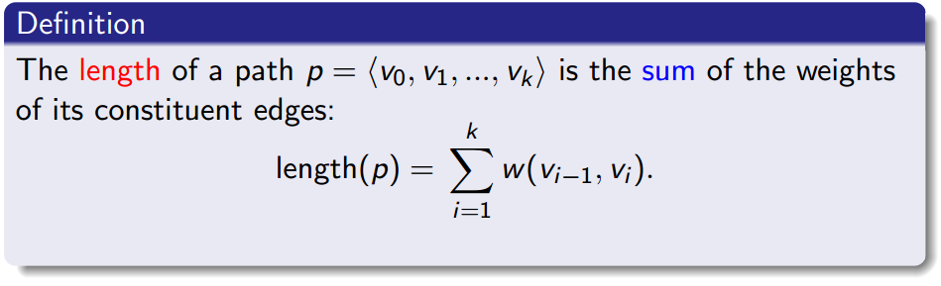
Shortest Path Problem for Weighted Graphs
Let G = (V, E) be a weighted digraph (directed graph), with weight function $w:E⟼ℝ$ mapping edges to real-valued weights
If e = (u, v), we write w(u, v) for w(e).

Slide 11
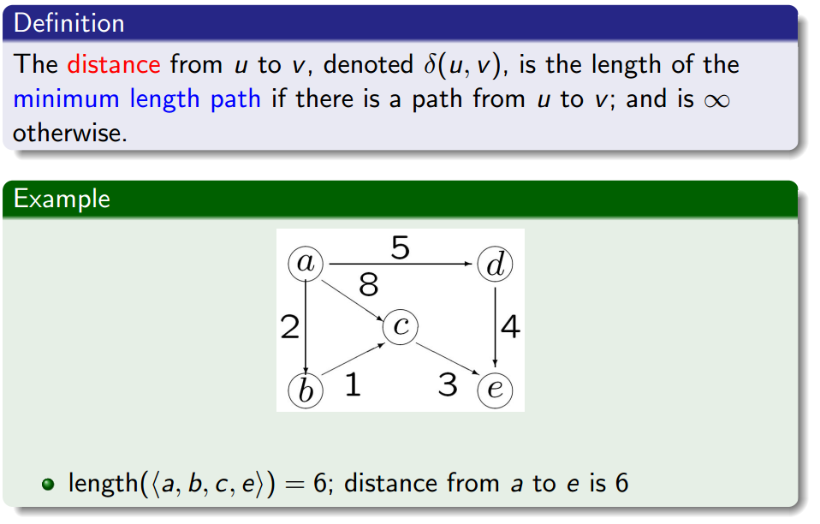
Distance

Slide 12
Distance

Slide 13
Distance

Slide 14
Distance

Slide 15
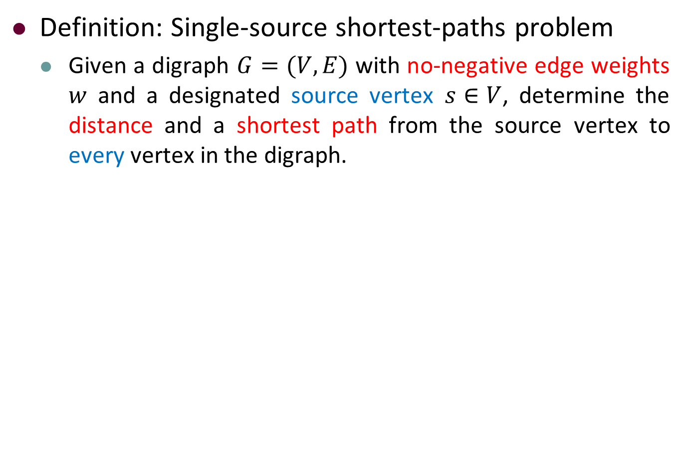
Single-Source Shortest-Paths Problem
Definition: Single-source shortest-paths problem
Given a digraph $G=(V,E)$ with no-negative edge weights $w$ and a designated source vertex $s∈V$, determine the distance and a shortest path from the source vertex to every vertex in the digraph.

Slide 16
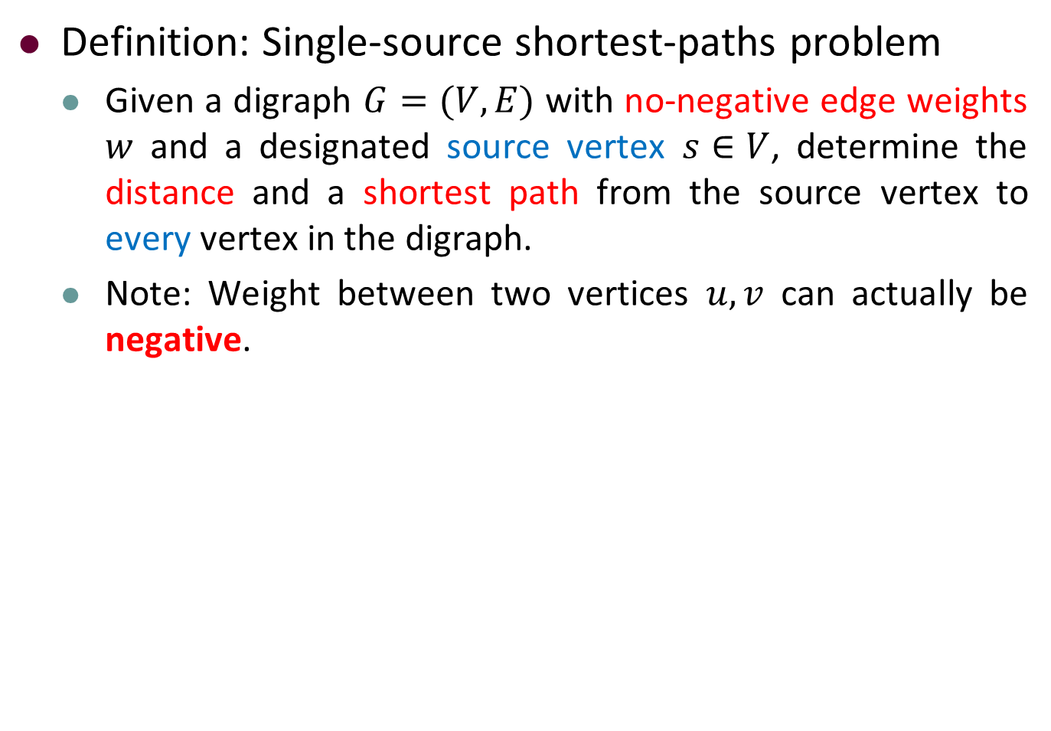
Single-Source Shortest-Paths Problem
Definition: Single-source shortest-paths problem
Given a digraph $G=(V,E)$ with no-negative edge weights $w$ and a designated source vertex $s∈V$, determine the distance and a shortest path from the source vertex to every vertex in the digraph.
Note: Weight between two vertices $u,v$ can actually be negative.

Slide 17
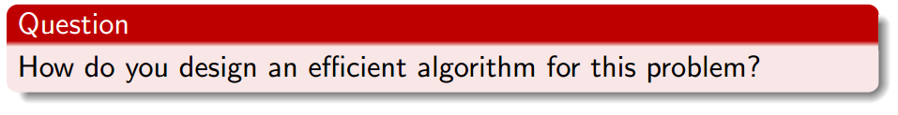
Single-Source Shortest-Paths Problem
Definition: Single-source shortest-paths problem
Given a digraph $G=(V,E)$ with no-negative edge weights $w$ and a designated source vertex $s∈V$, determine the distance and a shortest path from the source vertex to every vertex in the digraph.
Note: Weight between two vertices $u,v$ can actually be negative.

Slide 18
Outline
Review to Part IV
Single-Source Shortest Paths Problem
Dijkstra’s Algorithm
The idea
The algorithm
Analysis of Dijkstra’s algorithm
The Bellman-Ford Algorithm
The algorithm
Analysis of Bellman-Ford algorithm

Slide 19
The Rough Idea of Dijkstra’s Algorithm
Maintain d[v] and S:
d[v] is an upper bound of the length δ(s, v) of the shortest path for each vertex v.

Slide 20
The Rough Idea of Dijkstra’s Algorithm
Maintain d[v] and S:
d[v] is an upper bound of the length δ(s, v) of the shortest path for each vertex v.
S ⊆ V is a subset of vertices for which we know the true distance, that is d[v] = δ(s, v).

Slide 21
The Rough Idea of Dijkstra’s Algorithm
Maintain d[v] and S:
d[v] is an upper bound of the length δ(s, v) of the shortest path for each vertex v.
S ⊆ V is a subset of vertices for which we know the true distance, that is d[v] = δ(s, v).
Initially
S =

Slide 22
The Rough Idea of Dijkstra’s Algorithm
Maintain d[v] and S:
d[v] is an upper bound of the length δ(s, v) of the shortest path for each vertex v.
S ⊆ V is a subset of vertices for which we know the true distance, that is d[v] = δ(s, v).
Initially
S = ∅
d[s] =

Slide 23
The Rough Idea of Dijkstra’s Algorithm
Maintain d[v] and S:
d[v] is an upper bound of the length δ(s, v) of the shortest path for each vertex v.
S ⊆ V is a subset of vertices for which we know the true distance, that is d[v] = δ(s, v).
Initially
S = ∅
d[s] = 0 and d[v] = ∞ for all others vertices v.

Slide 24
The Rough Idea of Dijkstra’s Algorithm
Maintain d[v] and S:
d[v] is an upper bound of the length δ(s, v) of the shortest path for each vertex v.
S ⊆ V is a subset of vertices for which we know the true distance, that is d[v] = δ(s, v).
Initially
S = ∅
d[s] = 0 and d[v] = ∞ for all others vertices v.
One by one we select vertices from V \ S to add to S.

Slide 25
The Rough Idea of Dijkstra’s Algorithm
Maintain d[v] and S:
d[v] is an upper bound of the length δ(s, v) of the shortest path for each vertex v.
S ⊆ V is a subset of vertices for which we know the true distance, that is d[v] = δ(s, v).
Initially
S = ∅
d[s] = 0 and d[v] = ∞ for all others vertices v.
One by one we select vertices from V \ S to add to S.
Questions to answer at each step:

Slide 26
The Rough Idea of Dijkstra’s Algorithm
Maintain d[v] and S:
d[v] is an upper bound of the length δ(s, v) of the shortest path for each vertex v.
S ⊆ V is a subset of vertices for which we know the true distance, that is d[v] = δ(s, v).
Initially
S = ∅
d[s] = 0 and d[v] = ∞ for all others vertices v.
One by one we select vertices from V \ S to add to S.
Questions to answer at each step:
Which vertex do we select?
How do we update the distance upper bounds after a vertex is added to S?

Slide 27
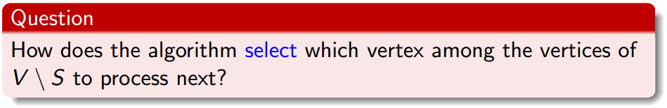
Selection of Vertex

Slide 28
Selection of Vertex
Answer: We use a greedy algorithm.

Slide 29
Selection of Vertex
Answer: We use a greedy algorithm.
For each vertex in u ∈ V \ S, we have computed a distance upper bound d[u].

Slide 30
Selection of Vertex
Answer: We use a greedy algorithm.
For each vertex in u ∈ V \ S, we have computed a distance upper bound d[u].
The next vertex processed is always a vertex u ∈ V \ S for which d[u] is minimum

Slide 31
Selection of Vertex
Answer: We use a greedy algorithm.
For each vertex in u ∈ V \ S, we have computed a distance upper bound d[u].
The next vertex processed is always a vertex u ∈ V \ S for which d[u] is minimum
that is, we take the unprocessed vertex that is closest (by our estimate) to s.

Slide 32
Updating Distance Estimates
Current distance upper bound for v: d[v].

Slide 33
Updating Distance Estimates
Current distance upper bound for v: d[v].
Vertex u just added to S. Edge (u, v) with weight w(u, v).

Slide 34
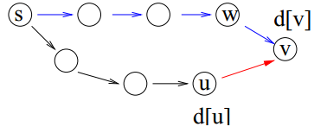
Updating Distance Estimates
Current distance upper bound for v: d[v].
Vertex u just added to S. Edge (u, v) with weight w(u, v).
How do we update d[v]?
Current shortest path to v: <s, …, w, v>, length d[v].

Slide 35
Updating Distance Estimates
Current distance upper bound for v: d[v].
Vertex u just added to S. Edge (u, v) with weight w(u, v).
How do we update d[v]?
Current shortest path to v: <s, …, w, v>, length d[v].
New path to v: <s, …, u, v>, length d[u] + w(u,v).

Slide 36
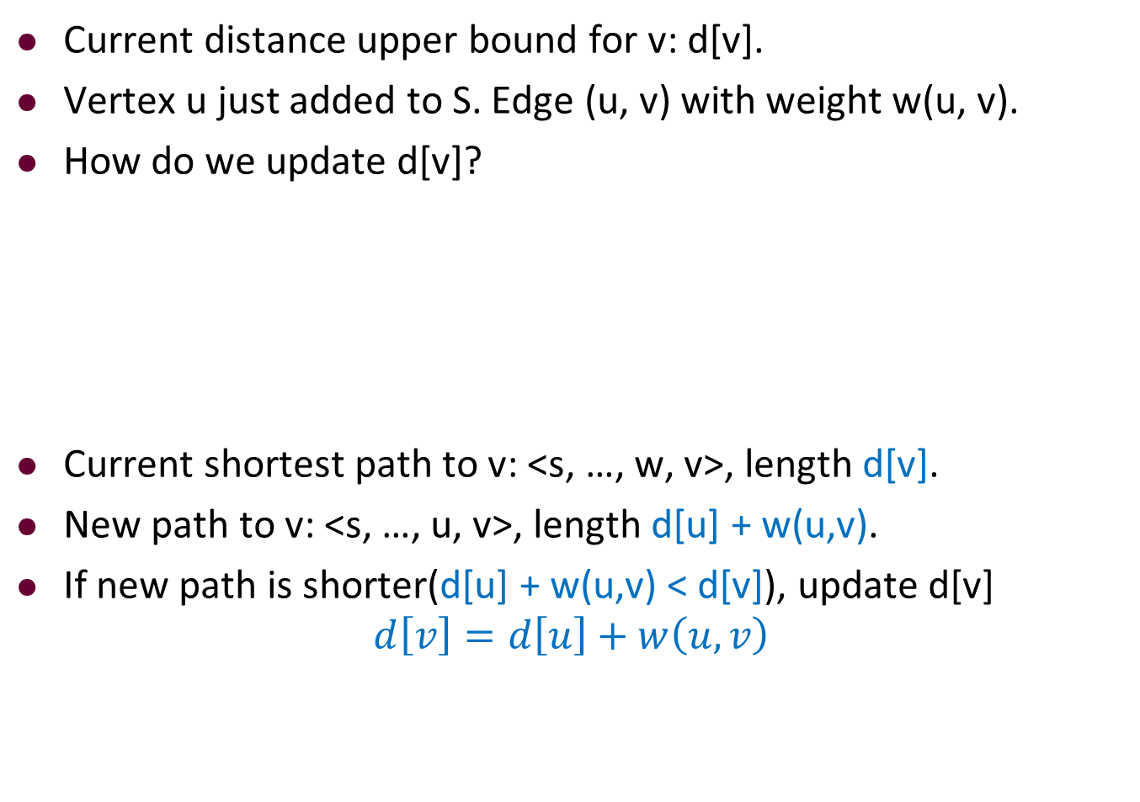
Updating Distance Estimates
Current distance upper bound for v: d[v].
Vertex u just added to S. Edge (u, v) with weight w(u, v).
How do we update d[v]?
Current shortest path to v: <s, …, w, v>, length d[v].
New path to v: <s, …, u, v>, length d[u] + w(u,v).
If new path is shorter(d[u] + w(u,v) < d[v]), update d[v]
$$d\left[v\right]=d\left[u\right]+w\left(u,v\right)$$

Slide 37
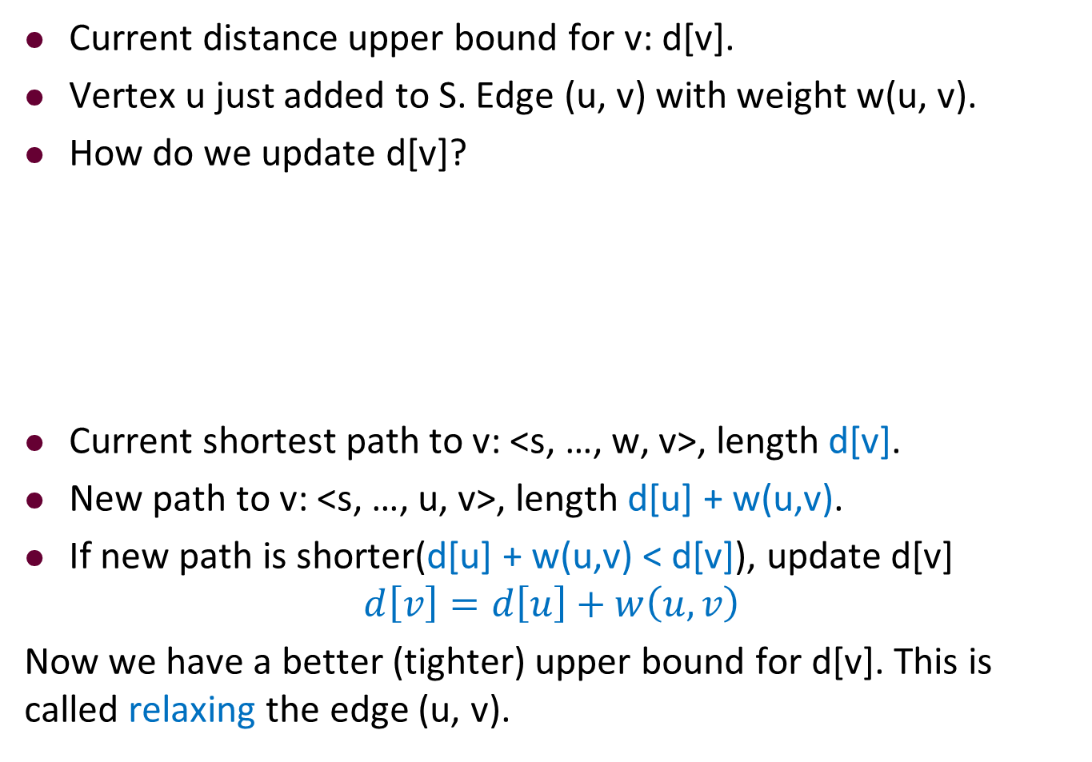
Updating Distance Estimates
Current distance upper bound for v: d[v].
Vertex u just added to S. Edge (u, v) with weight w(u, v).
How do we update d[v]?
Current shortest path to v: <s, …, w, v>, length d[v].
New path to v: <s, …, u, v>, length d[u] + w(u,v).
If new path is shorter(d[u] + w(u,v) < d[v]), update d[v]
$$d\left[v\right]=d\left[u\right]+w\left(u,v\right)$$
Now we have a better (tighter) upper bound for d[v]. This is called relaxing the edge (u, v).

Slide 38
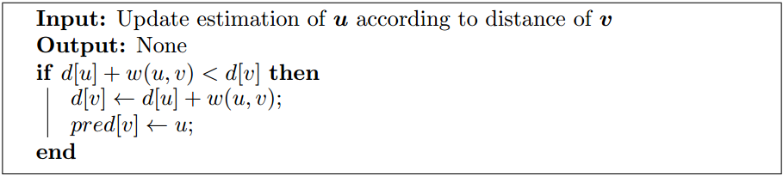
The Algorithm for Relaxing an Edge

Slide 39
The Algorithm for Relaxing an Edge

Slide 40
The Algorithm for Relaxing an Edge

Slide 41
The Algorithm for Relaxing an Edge

Slide 42
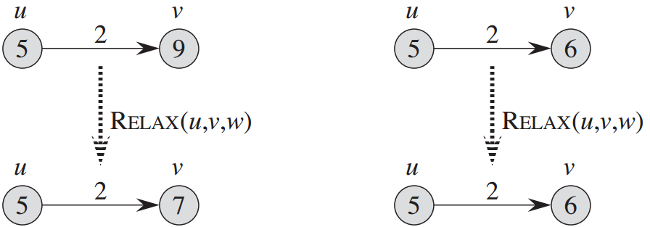
The Algorithm for Relaxing an Edge: An Example

Slide 43
The Algorithm for Relaxing an Edge
Remark 1: The predecessor pointer pred[ ] is for determining the shortest paths.
Remark 2: After edge (u, v) is relaxed, we have
$$d\left[v\right]≤d\left[u\right]+w(u,v)$$

Slide 44
Outline
Review to Part IV
Single-Source Shortest Paths Problem
Dijkstra’s Algorithm
The idea
The algorithm
Analysis of Dijkstra’s algorithm
The Bellman-Ford Algorithm(Optional)
The algorithm
Analysis of Bellman-Ford algorithm

Slide 45

The Selection in Dijkstra’s Algorithm

Slide 46
The Selection in Dijkstra’s Algorithm
Answer: We store the vertices of V \ S in a

Slide 47
The Selection in Dijkstra’s Algorithm
Answer: We store the vertices of V \ S in a Priority queue, where the key value of each vertex v is

Slide 48
The Selection in Dijkstra’s Algorithm
Answer: We store the vertices of V \ S in a Priority queue, where the key value of each vertex v is d[v].

Slide 49
The Selection in Dijkstra’s Algorithm
Answer: We store the vertices of V \ S in a Priority queue, where the key value of each vertex v is d[v].
Note: if we implement the priority queue using a heap, we can perform the operations Insert(), Extract-Min(), and Decrease-Key(), each in O( ) time.

Slide 50
The Selection in Dijkstra’s Algorithm
Answer: We store the vertices of V \ S in a Priority queue, where the key value of each vertex v is d[v].
Note: if we implement the priority queue using a heap, we can perform the operations Insert(), Extract-Min(), and Decrease-Key(), each in O(log n) time.

Slide 51
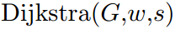
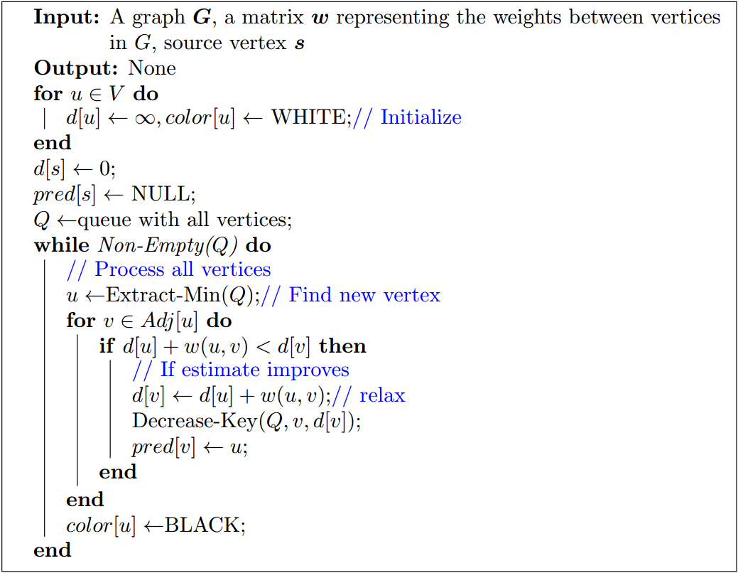
Description of Dijkstra’s Algorithm

Slide 52
Description of Dijkstra’s Algorithm

Slide 53
Description of Dijkstra’s Algorithm

Slide 54
Description of Dijkstra’s Algorithm

Slide 55
Description of Dijkstra’s Algorithm

Slide 56
Description of Dijkstra’s Algorithm

Slide 57
Description of Dijkstra’s Algorithm

Slide 58
Description of Dijkstra’s Algorithm

Slide 59
Description of Dijkstra’s Algorithm

Slide 60
Description of Dijkstra’s Algorithm

Slide 61
Description of Dijkstra’s Algorithm

Slide 62
Description of Dijkstra’s Algorithm

Slide 63
Description of Dijkstra’s Algorithm

Slide 64
Description of Dijkstra’s Algorithm

Slide 65
Description of Dijkstra’s Algorithm

Slide 66
Description of Dijkstra’s Algorithm

Slide 67
An Example of Dijkstra’s Algorithm
color
pred
W
W
W
W
W
N
N
N
N
N
d
Q(Priority Queue)
∞
∞
∞
∞
∞
1
2
3
4
5
3
4
∞
1
∞
1
7
8
∞
2
3
4
5
2
∞
∞
5
2
5

Slide 68
An Example of Dijkstra’s Algorithm
color
pred
W
W
W
W
W
N
N
N
N
N
d
Q(Priority Queue)
∞
∞
∞
∞
∞
1
2
3
4
5
3
4
∞
1
∞
1
7
Source vertex
8
∞
2
3
4
5
2
∞
∞
5
2
5

Slide 69
An Example of Dijkstra’s Algorithm
color
pred
W
W
W
W
W
N
N
N
N
N
d
Q(Priority Queue)
0
∞
∞
∞
∞
1
2
3
4
5
3
4
∞
1
∞
1
7
8
0
2
3
4
5
2
∞
∞
5
2
5

Slide 70
An Example of Dijkstra’s Algorithm
color
pred
W
W
W
W
W
N
N
N
N
N
d
Q(Priority Queue)
0
∞
∞
∞
∞
1
2
3
4
5
3
4
∞
1
∞
1
7
8
0
2
3
4
5
2
∞
∞
5
2
5

Slide 71
An Example of Dijkstra’s Algorithm
color
pred
W
W
W
W
W
N
1
1
N
N
d
Q(Priority Queue)
0
2
7
∞
∞
1
2
3
4
5
3
4
7
1
∞
1
7
8
0
2
3
4
5
2
2
∞
5
2
5

Slide 72
An Example of Dijkstra’s Algorithm
color
pred
B
W
W
W
W
N
1
1
N
N
d
Q(Priority Queue)
0
2
7
∞
∞
1
2
3
4
5
3
4
7
1
∞
1
7
8
0
2
3
4
5
2
2
∞
5
2
5

Slide 73
An Example of Dijkstra’s Algorithm
color
pred
B
W
W
W
W
N
1
1
N
N
d
Q(Priority Queue)
0
2
7
∞
∞
1
2
3
4
5
3
4
7
1
∞
1
7
8
0
2
3
4
5
2
2
∞
5
2
5

Slide 74
An Example of Dijkstra’s Algorithm
color
pred
B
W
W
W
W
N
1
2
2
2
d
Q(Priority Queue)
0
2
5
10
7
1
2
3
4
5
3
4
5
1
10
1
7
8
0
2
3
4
5
2
2
7
5
2
5

Slide 75
An Example of Dijkstra’s Algorithm
color
pred
B
B
W
W
W
N
1
2
2
2
d
Q(Priority Queue)
0
2
5
10
7
1
2
3
4
5
3
4
5
1
10
1
7
8
0
2
3
4
5
2
2
7
5
2
5

Slide 76
An Example of Dijkstra’s Algorithm
color
pred
B
B
W
W
W
N
1
2
2
2
d
Q(Priority Queue)
0
2
5
10
7
1
2
3
4
5
3
4
5
1
10
1
7
8
0
2
3
4
5
2
2
7
5
2
5

Slide 77
An Example of Dijkstra’s Algorithm
color
pred
B
B
W
W
W
N
1
2
3
2
d
Q(Priority Queue)
0
2
5
6
7
1
2
3
4
5
3
4
5
1
6
1
7
8
0
2
3
4
5
2
2
7
5
2
5

Slide 78
An Example of Dijkstra’s Algorithm
color
pred
B
B
B
W
W
N
1
2
3
2
d
Q(Priority Queue)
0
2
5
6
7
1
2
3
4
5
3
4
5
1
6
1
7
8
0
2
3
4
5
2
2
7
5
2
5

Slide 79
An Example of Dijkstra’s Algorithm
color
pred
B
B
B
W
W
N
1
2
3
2
d
Q(Priority Queue)
0
2
5
6
7
1
2
3
4
5
3
4
5
1
6
1
7
8
0
2
3
4
5
2
2
7
5
2
5

Slide 80
An Example of Dijkstra’s Algorithm
color
pred
B
B
B
W
W
N
1
2
3
2
d
Q(Priority Queue)
0
2
5
6
7
1
2
3
4
5
3
4
5
1
6
1
7
8
0
2
3
4
5
2
d[5] is not needed to be updated because d[4]+4 > d[5]
2
7
5
2
5

Slide 81
An Example of Dijkstra’s Algorithm
color
pred
B
B
B
B
W
N
1
2
3
2
d
Q(Priority Queue)
0
2
5
6
7
1
2
3
4
5
3
4
5
1
6
1
7
8
0
2
3
4
5
2
2
7
5
2
5

Slide 82
An Example of Dijkstra’s Algorithm
color
pred
B
B
B
B
W
N
1
2
3
2
d
Q(Priority Queue)
0
2
5
6
7
1
2
3
4
5
3
4
5
1
6
1
7
8
0
2
3
4
5
2
2
7
5
2
5

Slide 83
An Example of Dijkstra’s Algorithm
color
pred
B
B
B
B
B
N
1
2
3
2
d
Q(Priority Queue)
0
2
5
6
7
1
2
3
4
5
3
4
5
1
6
1
7
8
0
2
3
4
5
2
2
7
5
2
5

Slide 84
An Example of Dijkstra’s Algorithm
color
pred
B
B
B
B
B
N
1
2
3
2
d
Q(Priority Queue)
0
2
5
6
7
1
2
3
4
5
3
4
5
1
6
1
7
8
0
2
3
4
5
2
2
7
5
2
5

Slide 85
Shortest Path Tree for Dijkstra’s Algorithm
Shortest Path Tree: T = (V ; A), where
$$A=\{(pred\left[v\right],v)|v∈V\backslash \{s\}\}$$

Slide 86
Shortest Path Tree for Dijkstra’s Algorithm
Shortest Path Tree: T = (V ; A), where
$$A=\{(pred\left[v\right],v)|v∈V\backslash \{s\}\}$$
The array pred[v] is used to build the tree.

Slide 87
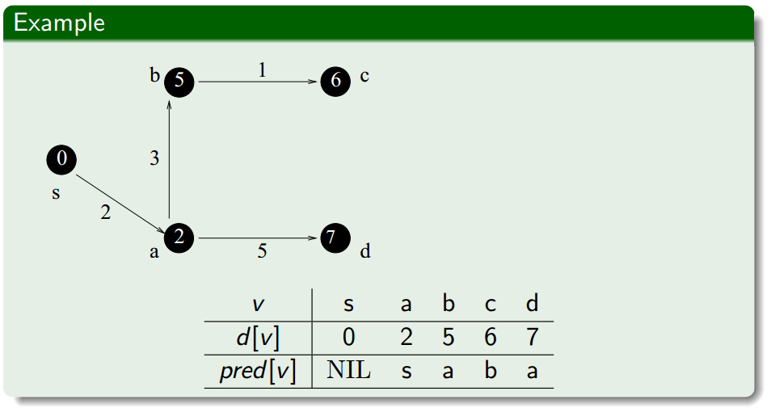
Shortest Path Tree for Dijkstra’s Algorithm
Shortest Path Tree: T = (V ; A), where
$$A=\{(pred\left[v\right],v)|v∈V\backslash \{s\}\}$$
The array pred[v] is used to build the tree.

Slide 88
Outline
Review to Part IV
Single-Source Shortest Paths Problem
Dijkstra’s Algorithm
The idea
The algorithm
Analysis of Dijkstra’s algorithm
The Bellman-Ford Algorithm
The algorithm
Analysis of Bellman-Ford algorithm

Slide 89
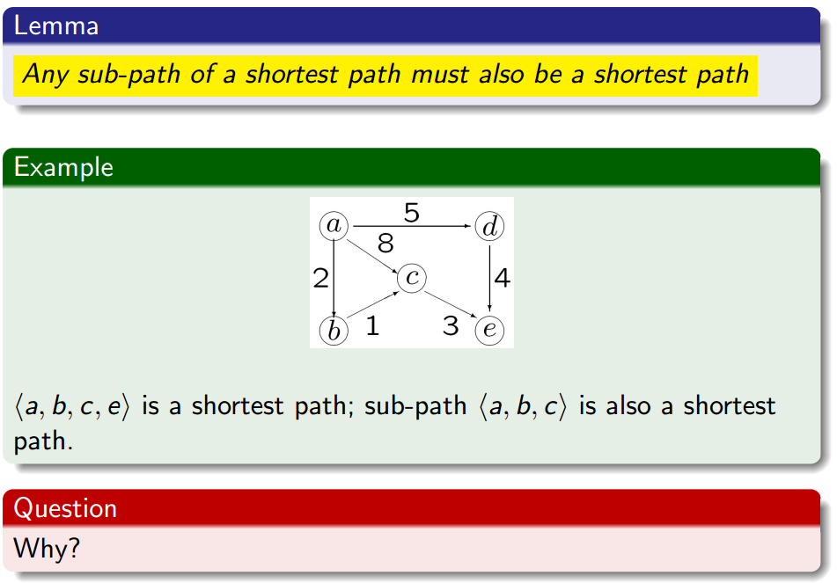
Observation

Slide 90
Observation

Slide 91
Observation

Slide 92
Observation

Slide 93
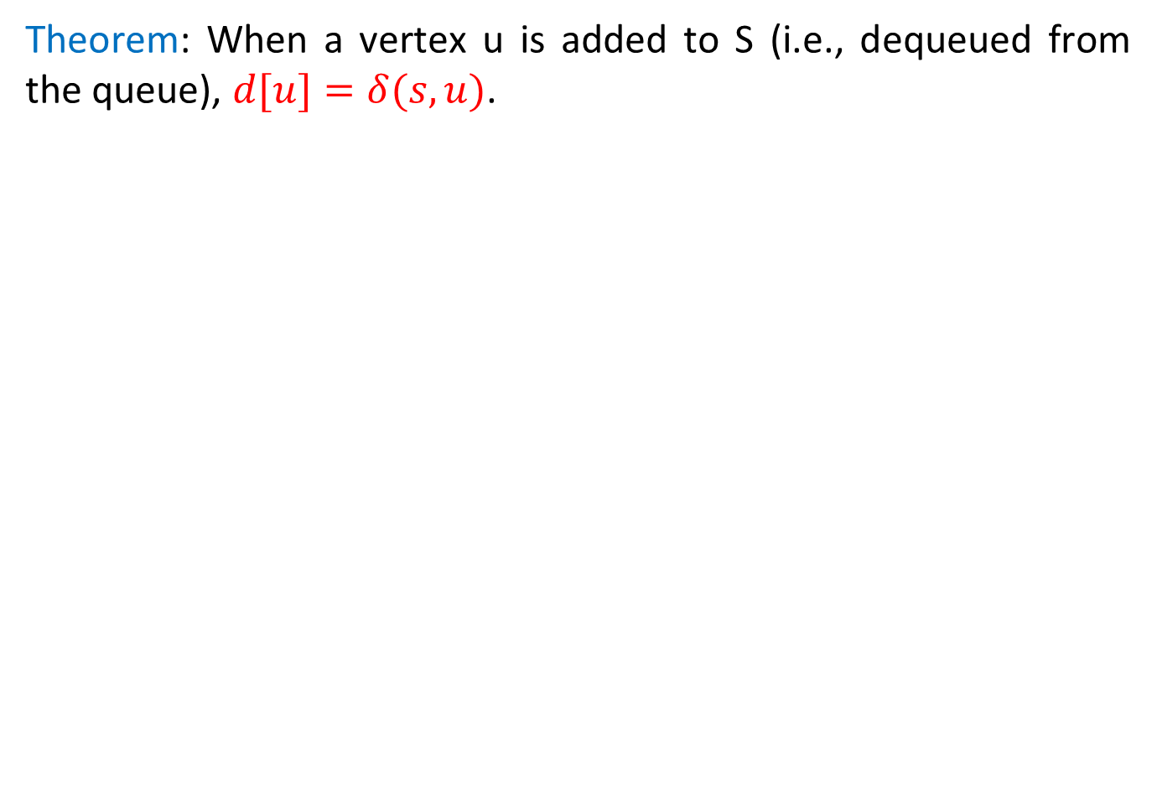
Correctness of Dijkstra’s Algorithm
Theorem: When a vertex u is added to S (i.e., dequeued from the queue), $d[u]=δ(s,u)$.

Slide 94
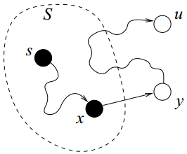
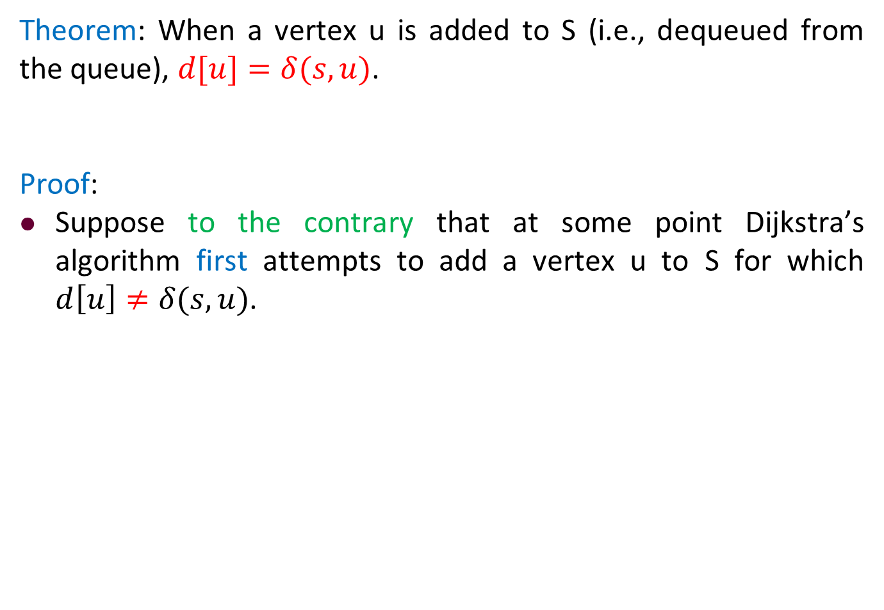
Correctness of Dijkstra’s Algorithm
Theorem: When a vertex u is added to S (i.e., dequeued from the queue), $d[u]=δ(s,u)$.
Proof:
Suppose to the contrary that at some point Dijkstra’s algorithm first attempts to add a vertex u to S for which $d\left[u\right]≠δ(s,u)$.

Slide 95
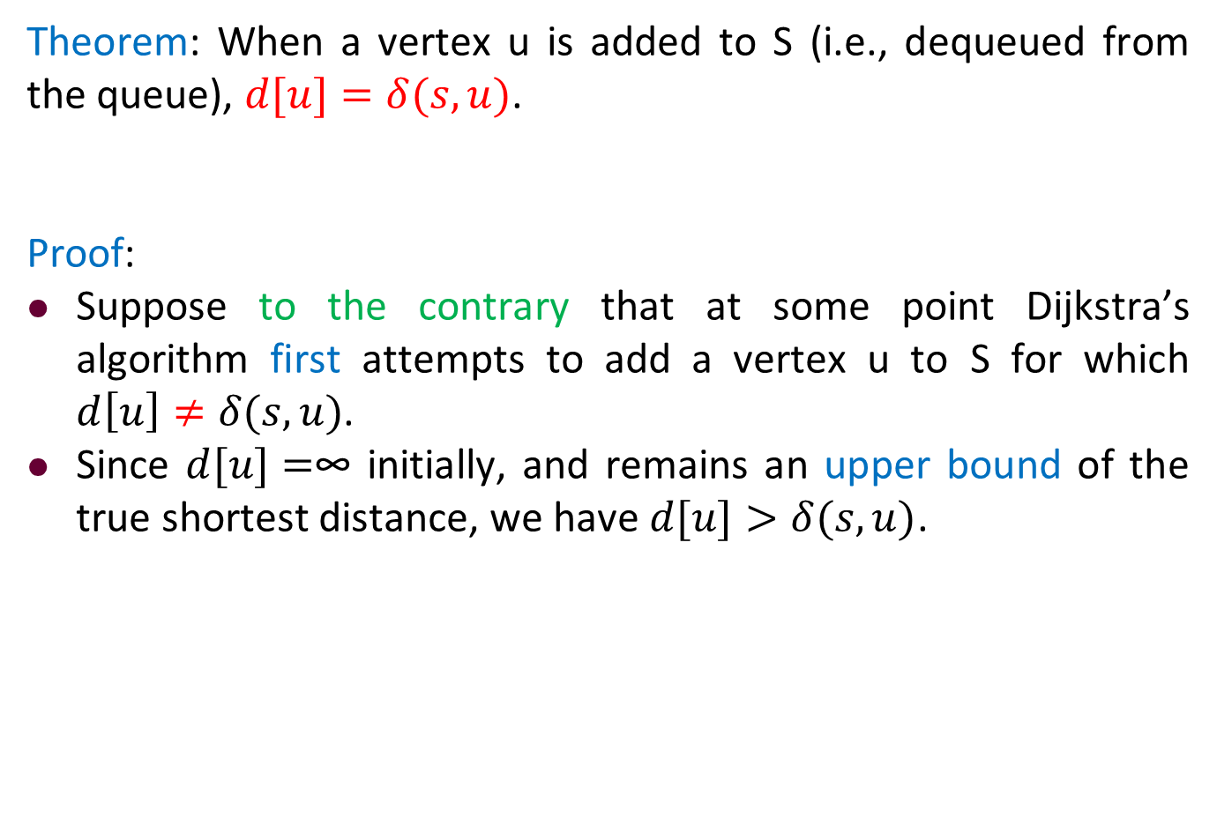
Correctness of Dijkstra’s Algorithm
Theorem: When a vertex u is added to S (i.e., dequeued from the queue), $d[u]=δ(s,u)$.
Proof:
Suppose to the contrary that at some point Dijkstra’s algorithm first attempts to add a vertex u to S for which $d\left[u\right]≠δ(s,u)$.
Since $d[u]=$∞ initially, and remains an upper bound of the true shortest distance, we have $d[u]>δ(s,u)$.

Slide 96

Correctness of Dijkstra’s Algorithm
Theorem: When a vertex u is added to S (i.e., dequeued from the queue), $d[u]=δ(s,u)$.
Proof:
Suppose to the contrary that at some point Dijkstra’s algorithm first attempts to add a vertex u to S for which $d\left[u\right]≠δ(s,u)$.
Since $d[u]=$∞ initially, and remains an upper bound of the true shortest distance, we have $d[u]>δ(s,u)$.
Consider the situation just prior to the insertion of u.

Slide 97
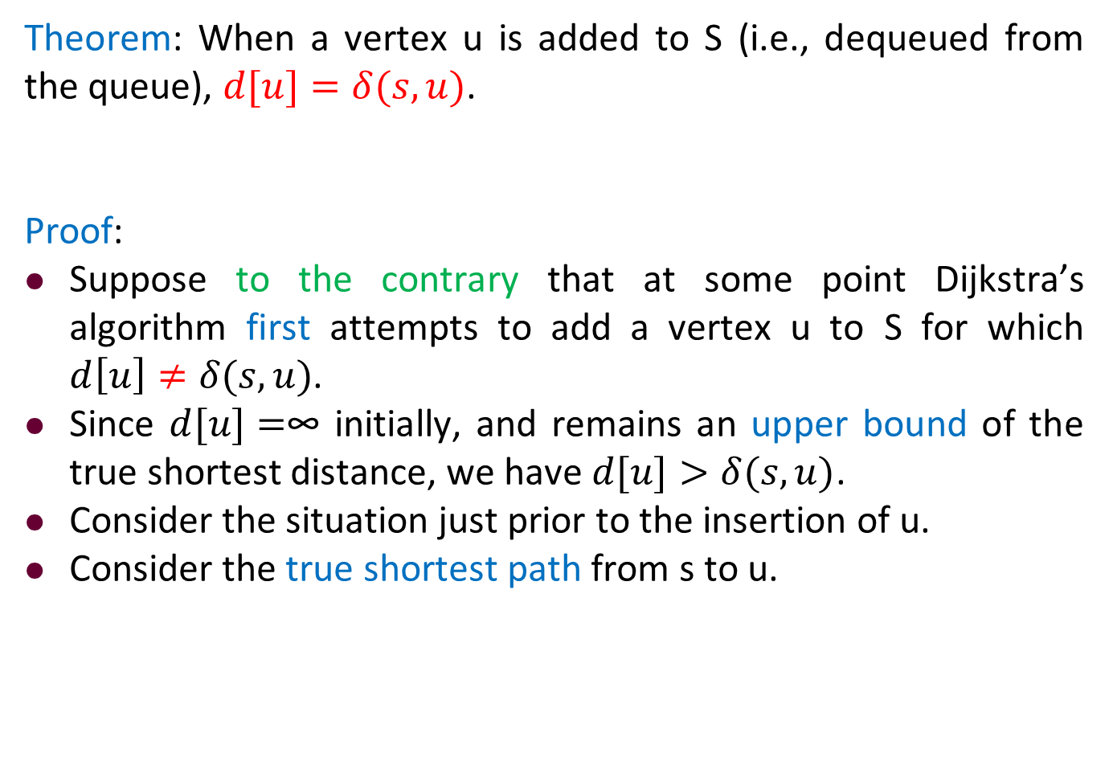
Correctness of Dijkstra’s Algorithm
Theorem: When a vertex u is added to S (i.e., dequeued from the queue), $d[u]=δ(s,u)$.
Proof:
Suppose to the contrary that at some point Dijkstra’s algorithm first attempts to add a vertex u to S for which $d\left[u\right]≠δ(s,u)$.
Since $d[u]=$∞ initially, and remains an upper bound of the true shortest distance, we have $d[u]>δ(s,u)$.
Consider the situation just prior to the insertion of u.
Consider the true shortest path from s to u.

Slide 98
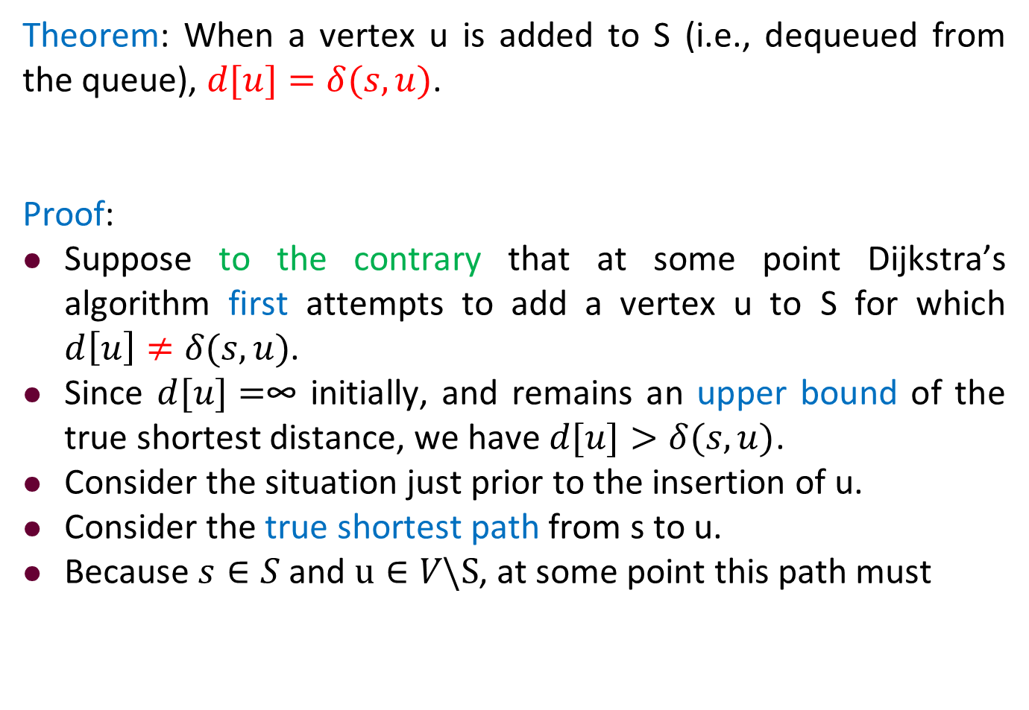
Correctness of Dijkstra’s Algorithm
Theorem: When a vertex u is added to S (i.e., dequeued from the queue), $d[u]=δ(s,u)$.
Proof:
Suppose to the contrary that at some point Dijkstra’s algorithm first attempts to add a vertex u to S for which $d\left[u\right]≠δ(s,u)$.
Since $d[u]=$∞ initially, and remains an upper bound of the true shortest distance, we have $d[u]>δ(s,u)$.
Consider the situation just prior to the insertion of u.
Consider the true shortest path from s to u.
Because $s∈S$ and $u∈V\backslash S$, at some point this path must

Slide 99
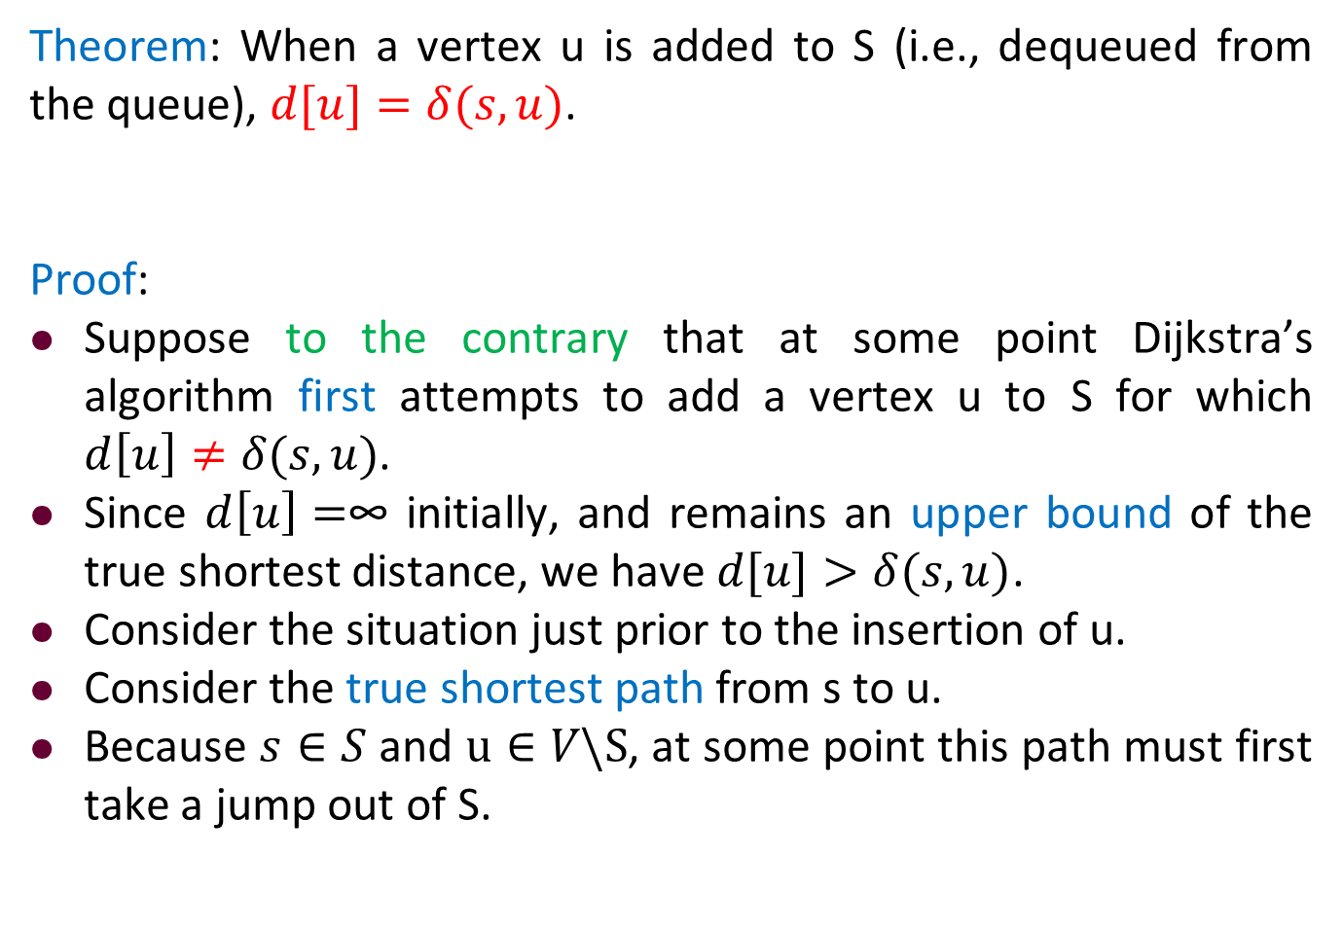
Correctness of Dijkstra’s Algorithm
Theorem: When a vertex u is added to S (i.e., dequeued from the queue), $d[u]=δ(s,u)$.
Proof:
Suppose to the contrary that at some point Dijkstra’s algorithm first attempts to add a vertex u to S for which $d\left[u\right]≠δ(s,u)$.
Since $d\left[u\right]=$∞ initially, and remains an upper bound of the true shortest distance, we have $d[u]>δ(s,u)$.
Consider the situation just prior to the insertion of u.
Consider the true shortest path from s to u.
Because $s∈S$ and $u∈V\backslash S$, at some point this path must first take a jump out of S.

Slide 100
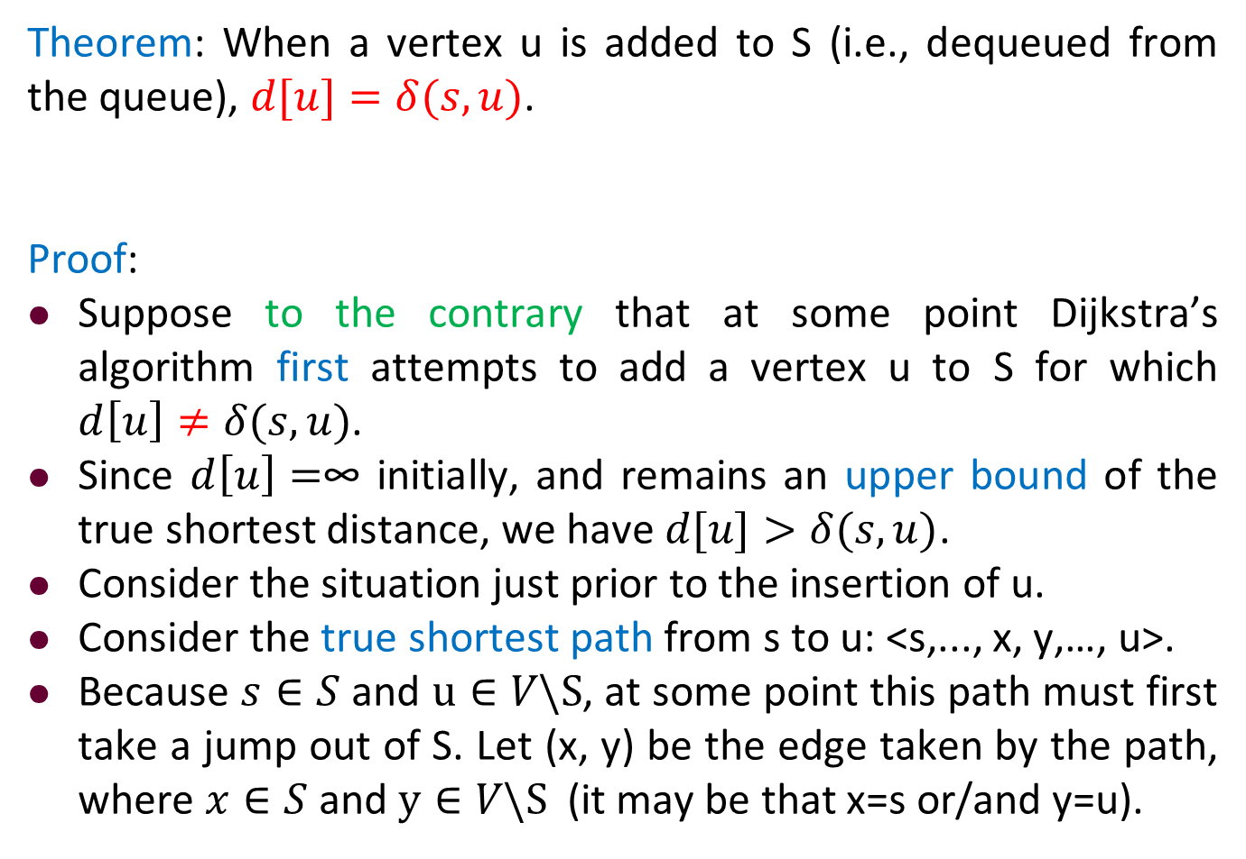
Correctness of Dijkstra’s Algorithm
Theorem: When a vertex u is added to S (i.e., dequeued from the queue), $d[u]=δ(s,u)$.
Proof:
Suppose to the contrary that at some point Dijkstra’s algorithm first attempts to add a vertex u to S for which $d\left[u\right]≠δ(s,u)$.
Since $d\left[u\right]=$∞ initially, and remains an upper bound of the true shortest distance, we have $d[u]>δ(s,u)$.
Consider the situation just prior to the insertion of u.
Consider the true shortest path from s to u: <s,..., x, y,…, u>.
Because $s∈S$ and $u∈V\backslash S$, at some point this path must first take a jump out of S. Let (x, y) be the edge taken by the path, where $x∈S$ and $y∈V\backslash S$ (it may be that x=s or/and y=u).

Slide 101
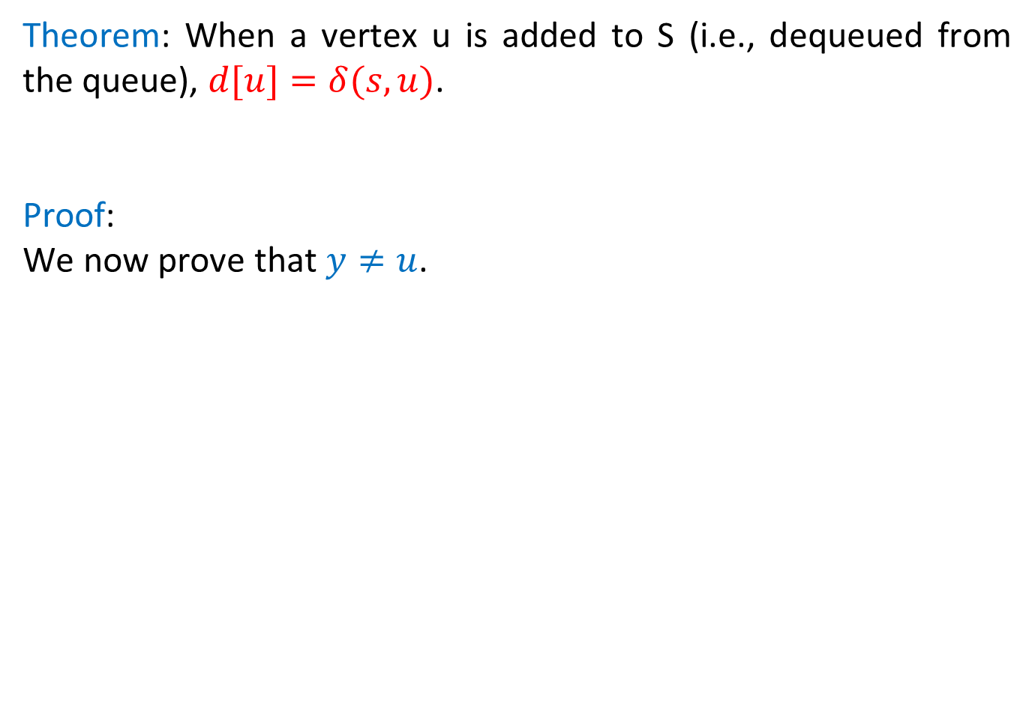
Correctness of Dijkstra’s Algorithm
Theorem: When a vertex u is added to S (i.e., dequeued from the queue), $d[u]=δ(s,u)$.
Proof:
We now prove that $y≠u$.

Slide 102
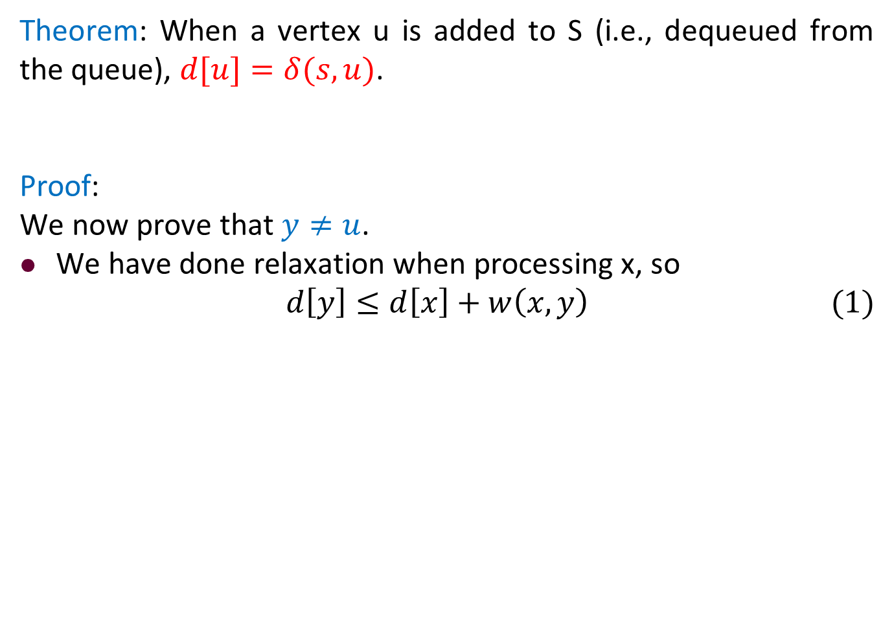
Correctness of Dijkstra’s Algorithm
Theorem: When a vertex u is added to S (i.e., dequeued from the queue), $d[u]=δ(s,u)$.
Proof:
We now prove that $y≠u$.
We have done relaxation when processing x, so
$$d\left[y\right]≤d\left[x\right]+w\left(x,y\right) (1)$$

Slide 103
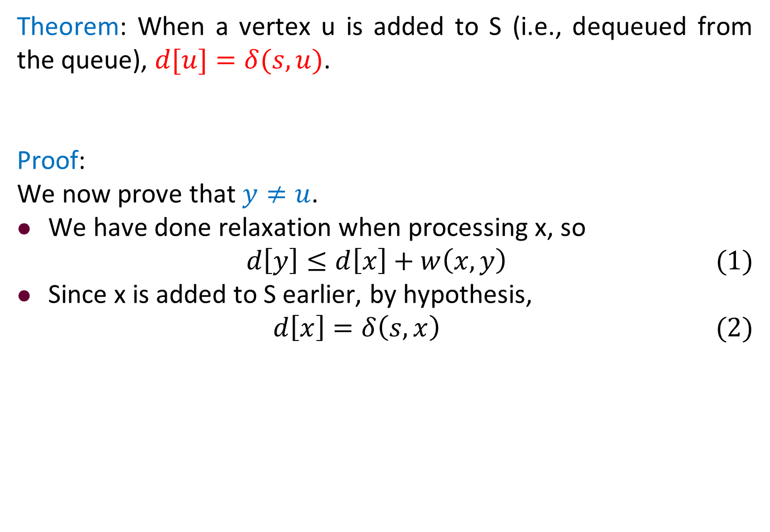
Correctness of Dijkstra’s Algorithm
Theorem: When a vertex u is added to S (i.e., dequeued from the queue), $d[u]=δ(s,u)$.
Proof:
We now prove that $y≠u$.
We have done relaxation when processing x, so
$$d\left[y\right]≤d\left[x\right]+w\left(x,y\right) (1)$$
Since x is added to S earlier, by hypothesis,
$$d\left[x\right]=δ\left(s,x\right) (2)$$

Slide 104
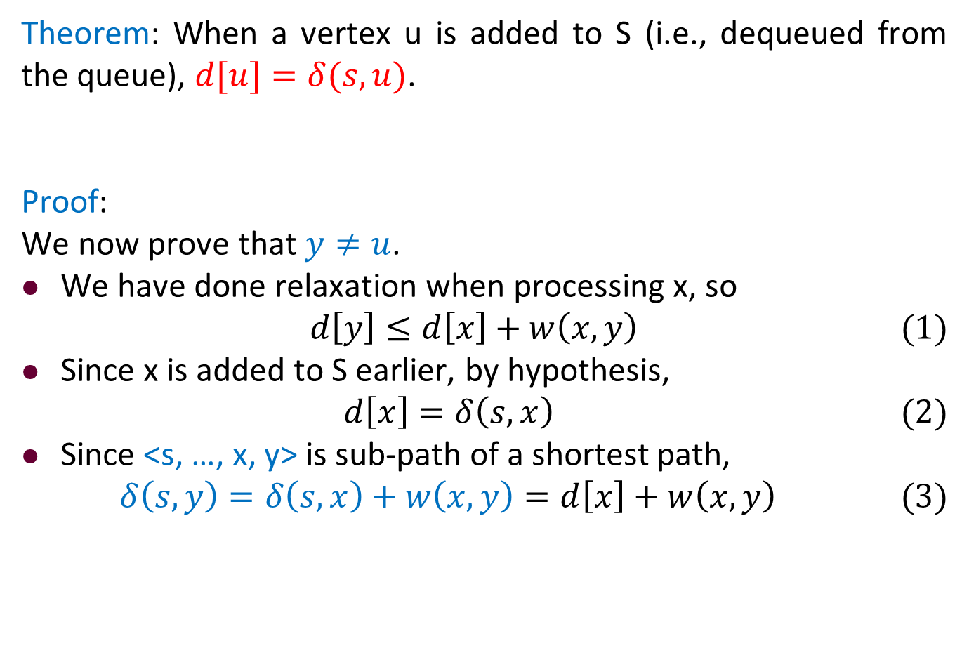
Correctness of Dijkstra’s Algorithm
Theorem: When a vertex u is added to S (i.e., dequeued from the queue), $d[u]=δ(s,u)$.
Proof:
We now prove that $y≠u$.
We have done relaxation when processing x, so
$$d\left[y\right]≤d\left[x\right]+w\left(x,y\right) (1)$$
Since x is added to S earlier, by hypothesis,
$$d\left[x\right]=δ\left(s,x\right) (2)$$
Since <s, …, x, y> is sub-path of a shortest path,
$$δ\left(s,y\right)=δ\left(s,x\right)+w\left(x,y\right)=d\left[x\right]+w\left(x,y\right) (3)$$

Slide 105
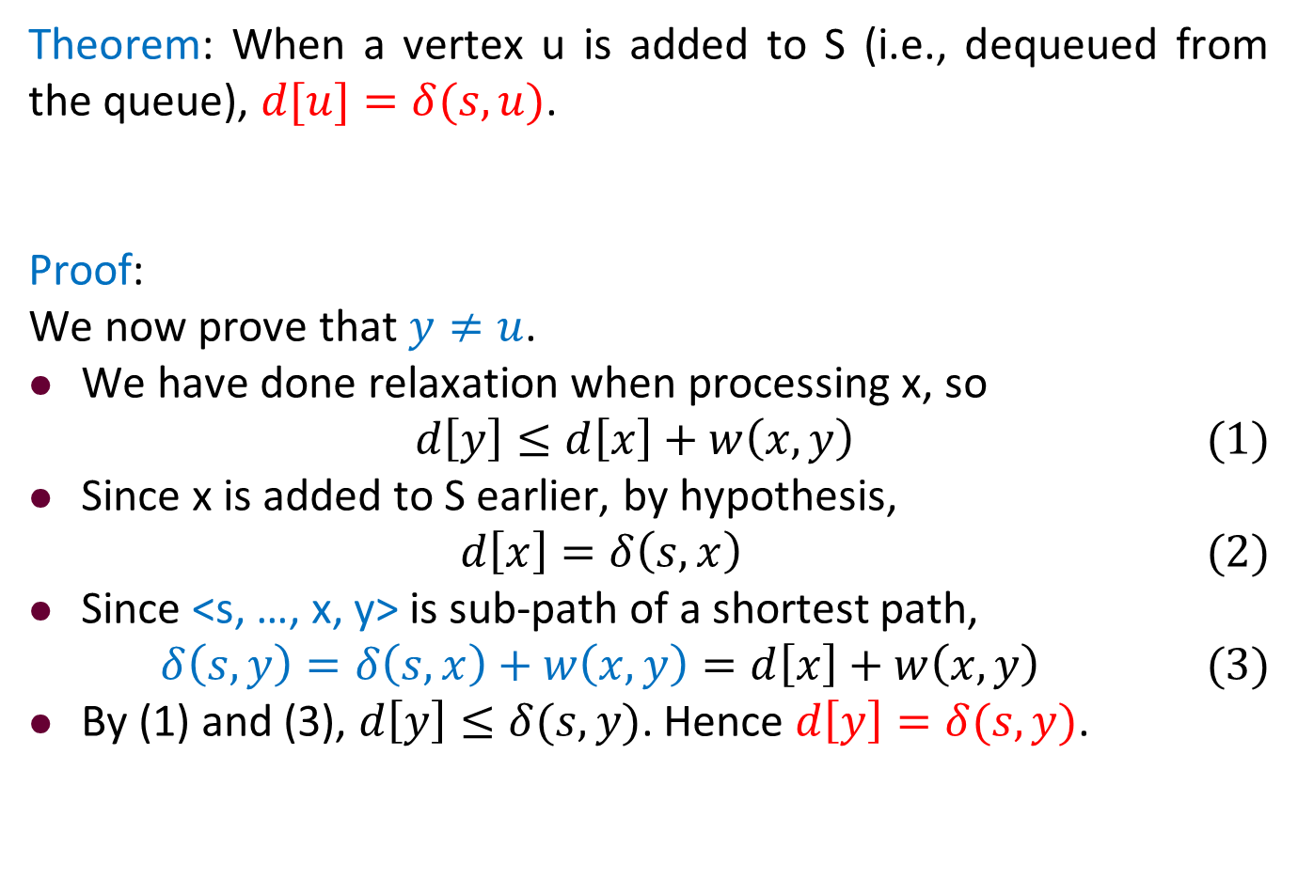
Correctness of Dijkstra’s Algorithm
Theorem: When a vertex u is added to S (i.e., dequeued from the queue), $d[u]=δ(s,u)$.
Proof:
We now prove that $y≠u$.
We have done relaxation when processing x, so
$$d\left[y\right]≤d\left[x\right]+w\left(x,y\right) (1)$$
Since x is added to S earlier, by hypothesis,
$$d\left[x\right]=δ\left(s,x\right) (2)$$
Since <s, …, x, y> is sub-path of a shortest path,
$$δ\left(s,y\right)=δ\left(s,x\right)+w\left(x,y\right)=d\left[x\right]+w\left(x,y\right) (3)$$
By (1) and (3), $d\left[y\right]≤δ(s,y)$. Hence $d\left[y\right]=δ(s,y)$.

Slide 106
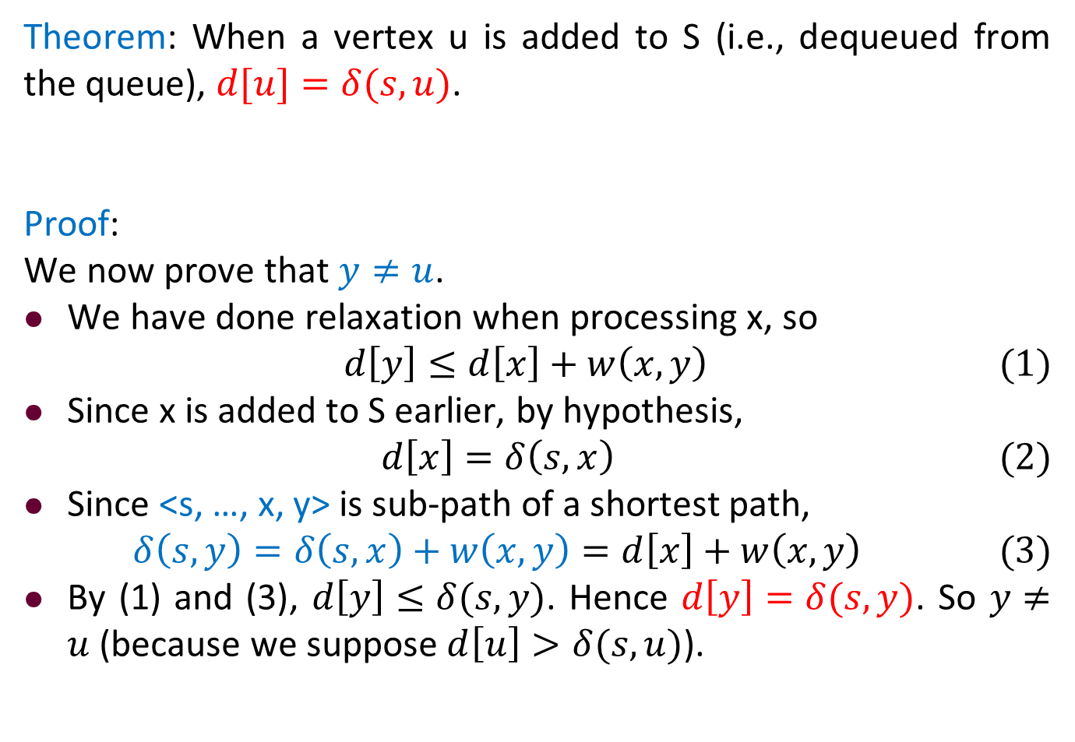
Correctness of Dijkstra’s Algorithm
Theorem: When a vertex u is added to S (i.e., dequeued from the queue), $d[u]=δ(s,u)$.
Proof:
We now prove that $y≠u$.
We have done relaxation when processing x, so
$$d\left[y\right]≤d\left[x\right]+w\left(x,y\right) (1)$$
Since x is added to S earlier, by hypothesis,
$$d\left[x\right]=δ\left(s,x\right) (2)$$
Since <s, …, x, y> is sub-path of a shortest path,
$$δ\left(s,y\right)=δ\left(s,x\right)+w\left(x,y\right)=d\left[x\right]+w\left(x,y\right) (3)$$
By (1) and (3), $d\left[y\right]≤δ(s,y)$. Hence $d\left[y\right]=δ(s,y)$. So $y≠u$ (because we suppose $d\left[u\right]>δ(s,u)$).

Slide 107
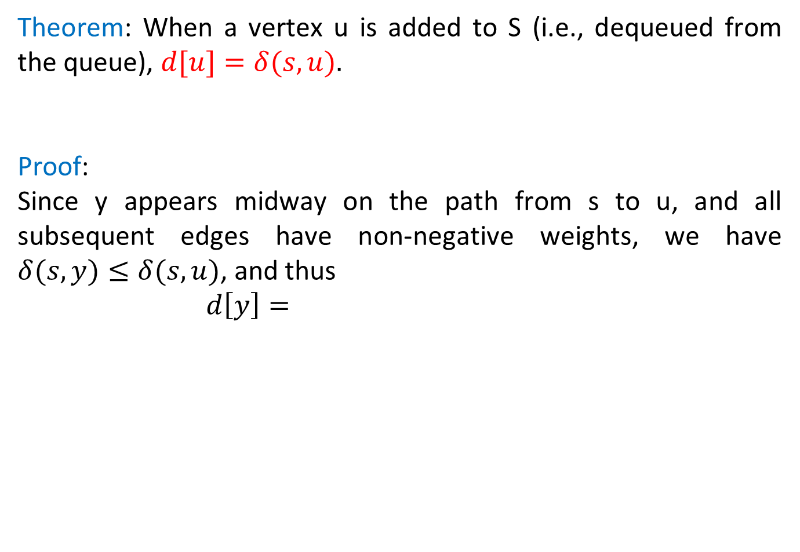
Correctness of Dijkstra’s Algorithm
Theorem: When a vertex u is added to S (i.e., dequeued from the queue), $d[u]=δ(s,u).$
Proof:
Since y appears midway on the path from s to u, and all subsequent edges have non-negative weights, we have $δ(s,y)≤δ(s,u)$, and thus
$$d\left[y\right]=$$

Slide 108

Correctness of Dijkstra’s Algorithm
Theorem: When a vertex u is added to S (i.e., dequeued from the queue), $d[u]=δ(s,u).$
Proof:
Since y appears midway on the path from s to u, and all subsequent edges have non-negative weights, we have $δ(s,y)≤δ(s,u)$, and thus
$$d\left[y\right]=δ\left(s,y\right)$$

Slide 109
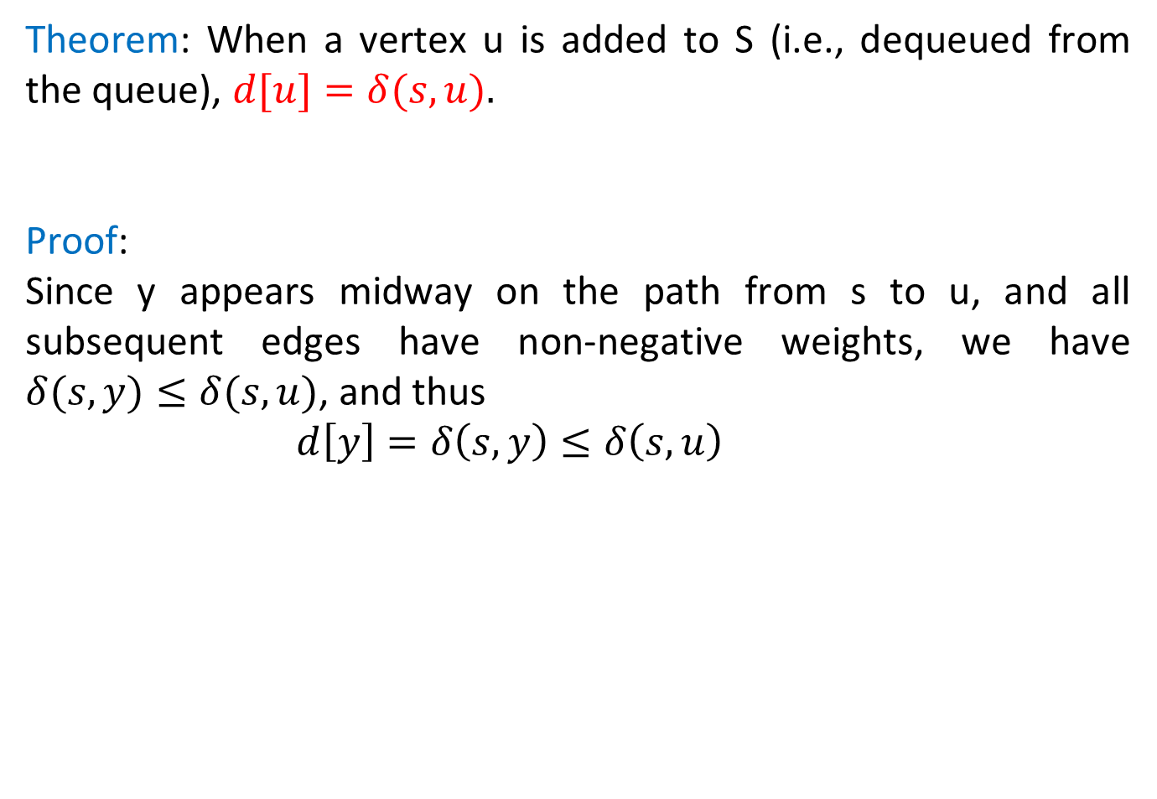
Correctness of Dijkstra’s Algorithm
Theorem: When a vertex u is added to S (i.e., dequeued from the queue), $d[u]=δ(s,u).$
Proof:
Since y appears midway on the path from s to u, and all subsequent edges have non-negative weights, we have $δ(s,y)≤δ(s,u)$, and thus
$$d\left[y\right]=δ\left(s,y\right)≤δ\left(s,u\right)$$

Slide 110

Correctness of Dijkstra’s Algorithm
Theorem: When a vertex u is added to S (i.e., dequeued from the queue), $d[u]=δ(s,u).$
Proof:
Since y appears midway on the path from s to u, and all subsequent edges have non-negative weights, we have $δ(s,y)≤δ(s,u)$, and thus
$$d\left[y\right]=δ\left(s,y\right)≤δ\left(s,u\right) d[u]$$

Slide 111

Correctness of Dijkstra’s Algorithm
Theorem: When a vertex u is added to S (i.e., dequeued from the queue), $d[u]=δ(s,u).$
Proof:
Since y appears midway on the path from s to u, and all subsequent edges have non-negative weights, we have $δ(s,y)≤δ(s,u)$, and thus
$$d\left[y\right]=δ\left(s,y\right)≤δ\left(s,u\right)<d[u]$$

Slide 112
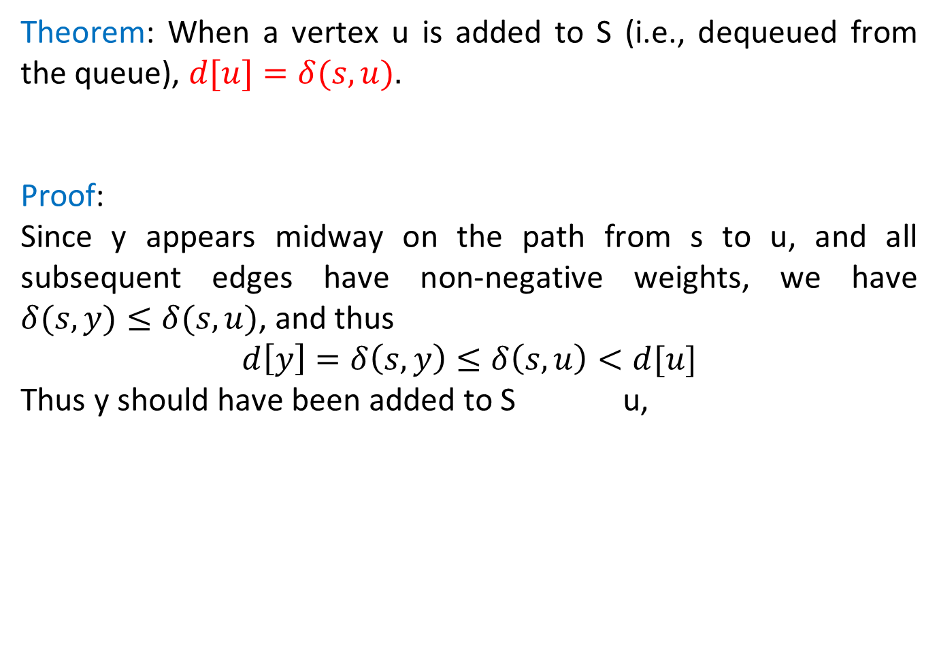
Correctness of Dijkstra’s Algorithm
Theorem: When a vertex u is added to S (i.e., dequeued from the queue), $d[u]=δ(s,u).$
Proof:
Since y appears midway on the path from s to u, and all subsequent edges have non-negative weights, we have $δ(s,y)≤δ(s,u)$, and thus
$$d\left[y\right]=δ\left(s,y\right)≤δ\left(s,u\right)<d[u]$$
Thus y should have been added to S u,

Slide 113
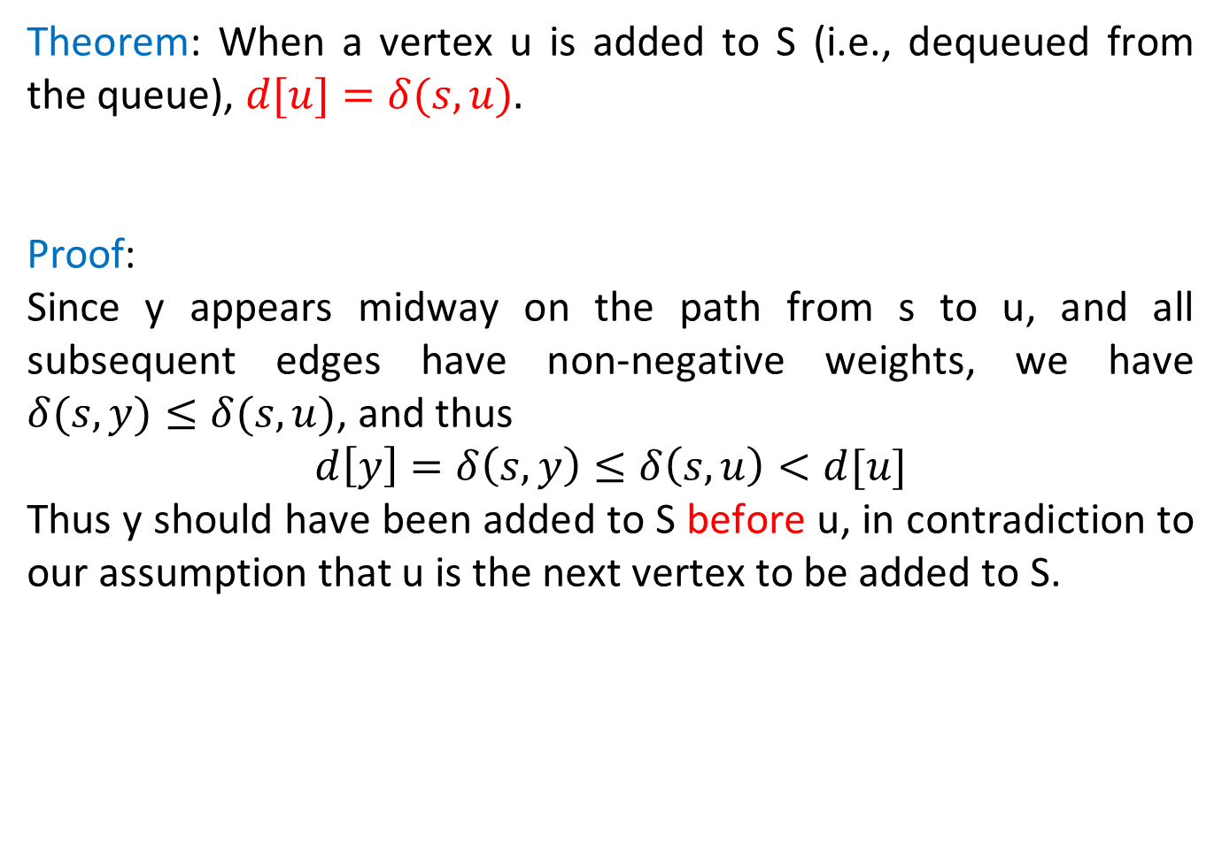
Correctness of Dijkstra’s Algorithm
Theorem: When a vertex u is added to S (i.e., dequeued from the queue), $d[u]=δ(s,u).$
Proof:
Since y appears midway on the path from s to u, and all subsequent edges have non-negative weights, we have $δ(s,y)≤δ(s,u)$, and thus
$$d\left[y\right]=δ\left(s,y\right)≤δ\left(s,u\right)<d[u]$$
Thus y should have been added to S before u, in contradiction to our assumption that u is the next vertex to be added to S.

Slide 114
Analysis of Dijkstra’s Algorithm
The initialization uses only O( ) time.

Slide 115
Analysis of Dijkstra’s Algorithm
The initialization uses only O(|V|) time.

Slide 116
Analysis of Dijkstra’s Algorithm
The initialization uses only O(|V|) time.
Each vertex is processed exactly once, so Non-Empty() and Extract-Min() are called exactly once,

Slide 117
Analysis of Dijkstra’s Algorithm
The initialization uses only O(|V|) time.
Each vertex is processed exactly once, so Non-Empty() and Extract-Min() are called exactly once, i.e., times in total.

Slide 118
Analysis of Dijkstra’s Algorithm
The initialization uses only O(|V|) time.
Each vertex is processed exactly once, so Non-Empty() and Extract-Min() are called exactly once, i.e., O(|V|) times in total.

Slide 119
Analysis of Dijkstra’s Algorithm
The initialization uses only O(|V|) time.
Each vertex is processed exactly once, so Non-Empty() and Extract-Min() are called exactly once, i.e., O(|V|) times in total.
The inner loop for (each v ∈ Adj[u]) is called once for each edge in the graph.

Slide 120
Analysis of Dijkstra’s Algorithm
The initialization uses only O(|V|) time.
Each vertex is processed exactly once, so Non-Empty() and Extract-Min() are called exactly once, i.e., O(|V|) times in total.
The inner loop for (each v ∈ Adj[u]) is called once for each edge in the graph. Each call of the inner loop does O(1) work

Slide 121
Analysis of Dijkstra’s Algorithm
The initialization uses only O(|V|) time.
Each vertex is processed exactly once, so Non-Empty() and Extract-Min() are called exactly once, i.e., O(|V|) times in total.
The inner loop for (each v ∈ Adj[u]) is called once for each edge in the graph. Each call of the inner loop does O(1) work plus, possibly, one Decrease-Key operation.

Slide 122
Analysis of Dijkstra’s Algorithm
The initialization uses only O(|V|) time.
Each vertex is processed exactly once, so Non-Empty() and Extract-Min() are called exactly once, i.e., O(|V|) times in total.
The inner loop for (each v ∈ Adj[u]) is called once for each edge in the graph. Each call of the inner loop does O(1) work plus, possibly, one Decrease-Key operation.
Recalling that all of the priority queue operations require O(log |Q|) = O(log|V|) time, we have that the algorithm uses

Slide 123
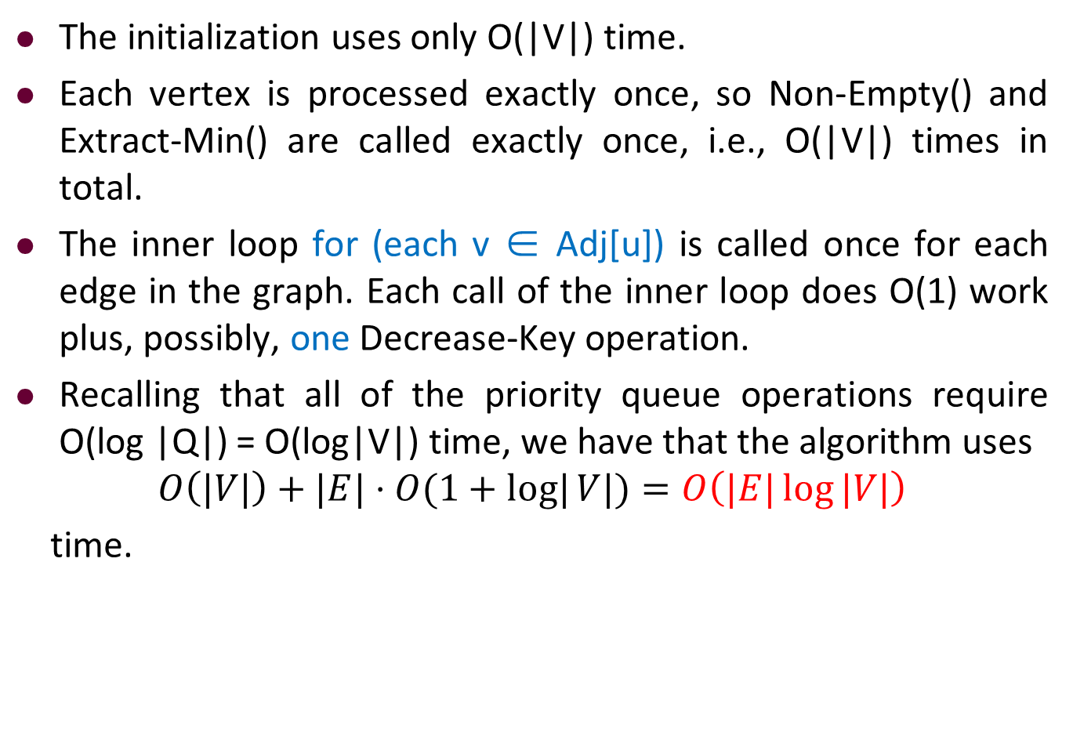
Analysis of Dijkstra’s Algorithm
The initialization uses only O(|V|) time.
Each vertex is processed exactly once, so Non-Empty() and Extract-Min() are called exactly once, i.e., O(|V|) times in total.
The inner loop for (each v ∈ Adj[u]) is called once for each edge in the graph. Each call of the inner loop does O(1) work plus, possibly, one Decrease-Key operation.
Recalling that all of the priority queue operations require O(log |Q|) = O(log|V|) time, we have that the algorithm uses
$$O\left(|V|\right)+|E|⋅O(1+log|{V|})=O\left(|E|\log{|V|}\right)$$
time.

Slide 124


Description of Dijkstra’s Algorithm
$$O(\left|V\right|)$$
$$O\left(log \left|V\right|\right)⋅|E|$$

Slide 125
Prim’s Algorithm vs. Dijkstra’s Algorithm
Dijkstra’s algorithm looks similar to Prim’s algorithm.
To understand the differences clearly, try them both on some example.

Slide 126
Outline
Review to Part IV
Single-Source Shortest Paths Problem
Dijkstra’s Algorithm
The idea
The algorithm
Analysis of Dijkstra’s algorithm
The Bellman-Ford Algorithm
The algorithm
Analysis of Bellman-Ford algorithm

Slide 127
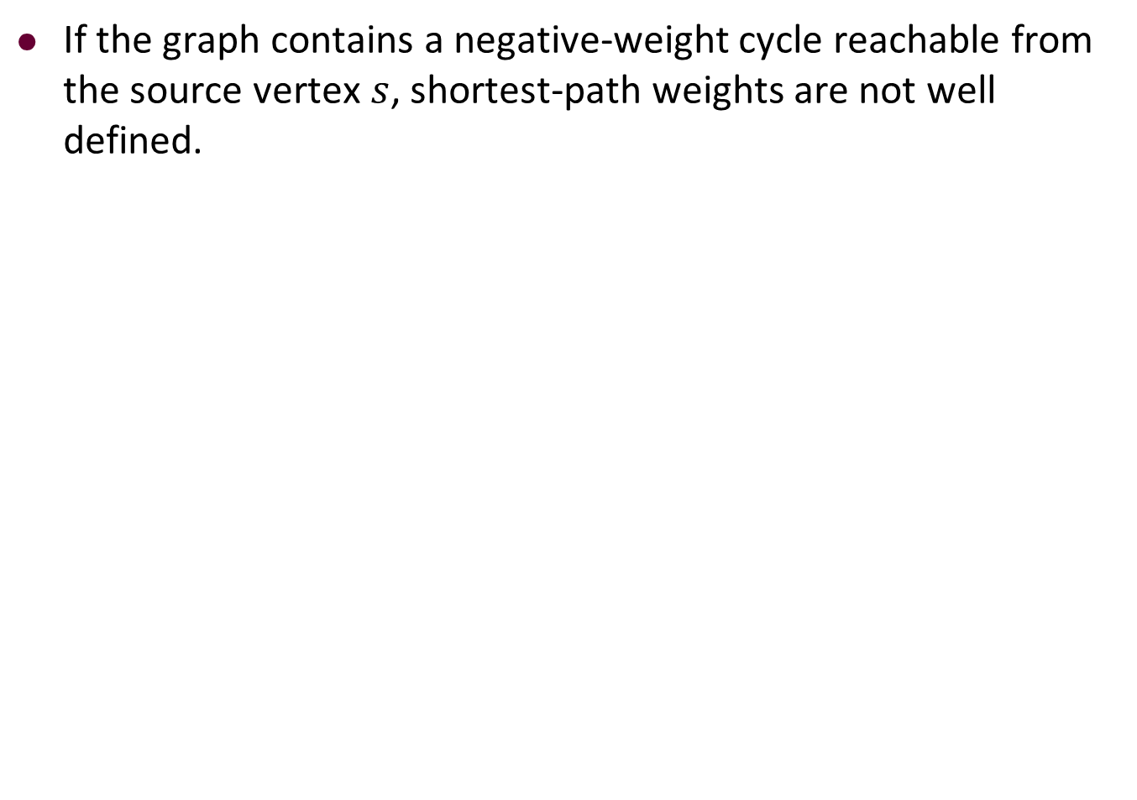
Negative-weight edges
If the graph contains a negative-weight cycle reachable from the source vertex $s$, shortest-path weights are not well defined.

Slide 128
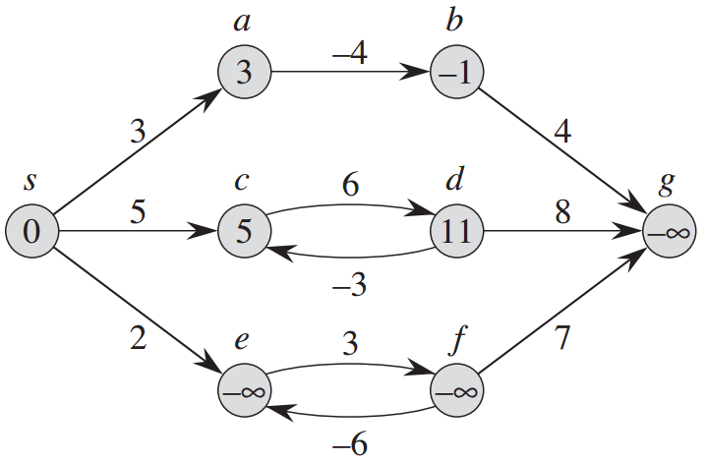
Negative-weight edges
If the graph contains a negative-weight cycle reachable from the source vertex $s$, shortest-path weights are not well defined.

Slide 129
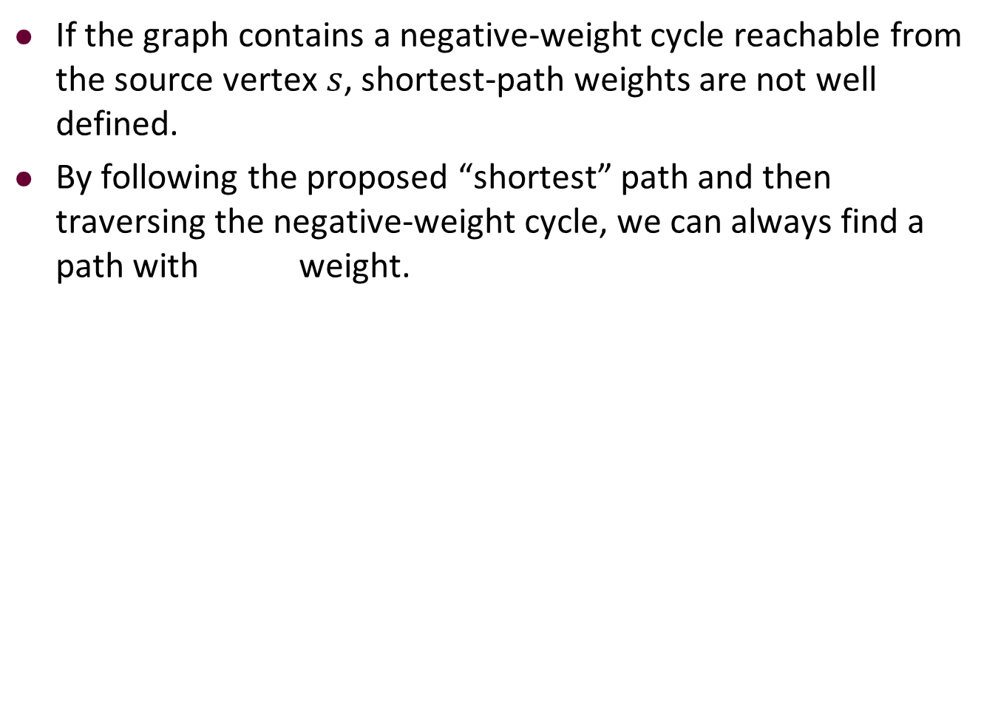
Negative-weight edges
If the graph contains a negative-weight cycle reachable from the source vertex $s$, shortest-path weights are not well defined.
By following the proposed “shortest” path and then traversing the negative-weight cycle, we can always find a path with weight.

Slide 130
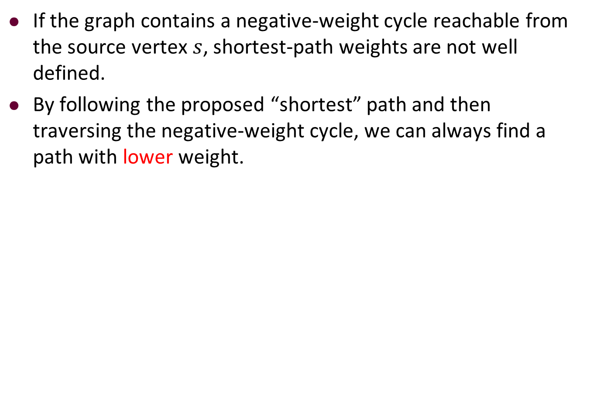
Negative-weight edges
If the graph contains a negative-weight cycle reachable from the source vertex $s$, shortest-path weights are not well defined.
By following the proposed “shortest” path and then traversing the negative-weight cycle, we can always find a path with lower weight.

Slide 131
Review of The Algorithm for Relaxing an Edge

Slide 132
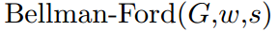
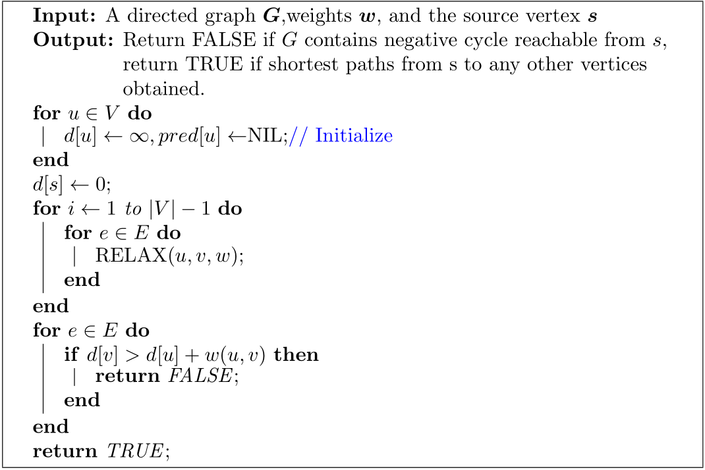
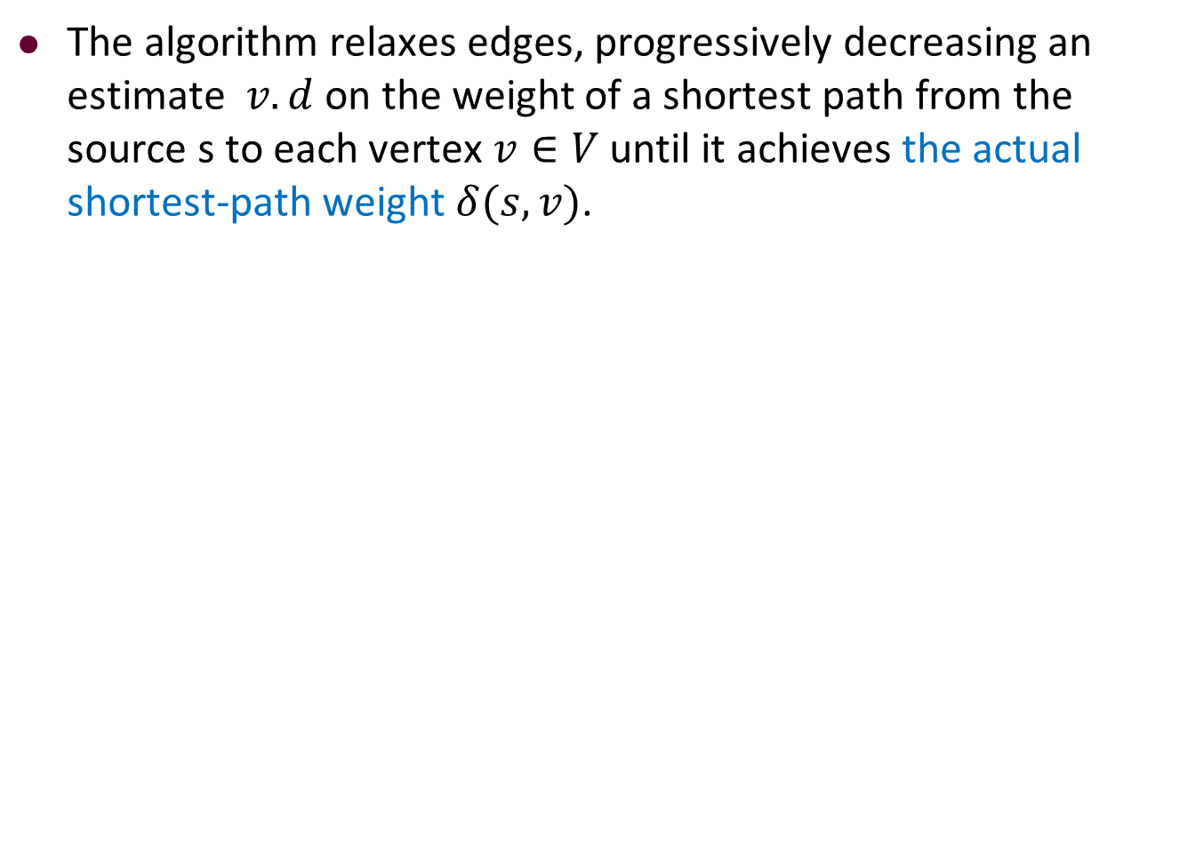
Description of Bellman-Ford Algorithm
The algorithm relaxes edges, progressively decreasing an estimate $v.d$ on the weight of a shortest path from the source s to each vertex $v∈V$ until it achieves the actual shortest-path weight $δ(s,v)$.

Slide 133
Description of Bellman-Ford Algorithm
The algorithm relaxes edges, progressively decreasing an estimate $v.d$ on the weight of a shortest path from the source s to each vertex $v∈V$ until it achieves the actual shortest-path weight $δ(s,v)$.

Slide 134
Description of Bellman-Ford Algorithm
The algorithm relaxes edges, progressively decreasing an estimate $v.d$ on the weight of a shortest path from the source s to each vertex $v∈V$ until it achieves the actual shortest-path weight $δ(s,v)$.

Slide 135
Description of Bellman-Ford Algorithm
The algorithm relaxes edges, progressively decreasing an estimate $v.d$ on the weight of a shortest path from the source s to each vertex $v∈V$ until it achieves the actual shortest-path weight $δ(s,v)$.

Slide 136
Description of Bellman-Ford Algorithm
The algorithm relaxes edges, progressively decreasing an estimate $v.d$ on the weight of a shortest path from the source s to each vertex $v∈V$ until it achieves the actual shortest-path weight $δ(s,v)$.

Slide 137
Description of Bellman-Ford Algorithm
The algorithm relaxes edges, progressively decreasing an estimate $v.d$ on the weight of a shortest path from the source s to each vertex $v∈V$ until it achieves the actual shortest-path weight $δ(s,v)$.

Slide 138
Description of Bellman-Ford Algorithm
The algorithm relaxes edges, progressively decreasing an estimate $v.d$ on the weight of a shortest path from the source s to each vertex $v∈V$ until it achieves the actual shortest-path weight $δ(s,v)$.

Slide 139
Description of Bellman-Ford Algorithm
The algorithm relaxes edges, progressively decreasing an estimate $v.d$ on the weight of a shortest path from the source s to each vertex $v∈V$ until it achieves the actual shortest-path weight $δ(s,v)$.

Slide 140
An Example of Bellman-Ford Algorithm
Initialization
d
pred
∞
∞
∞
∞
∞
N
N
N
N
N
3
4
∞
1
∞
1
7
8
∞
2
3
4
5
2
∞
∞
5
2
5

Slide 141
An Example of Bellman-Ford Algorithm
Initialization
d
pred
∞
∞
∞
∞
∞
N
N
N
N
N
3
4
∞
1
∞
1
7
Source vertex
8
∞
2
3
4
5
2
∞
∞
5
2
5

Slide 142
An Example of Bellman-Ford Algorithm
Initialization
d
pred
0
∞
∞
∞
∞
N
N
N
N
N
3
4
∞
1
∞
1
7
8
0
2
3
4
5
2
∞
∞
5
2
5

Slide 143
An Example of Bellman-Ford Algorithm
1st round
d
pred
0
∞
∞
∞
∞
N
N
N
N
N
3
4
∞
1
∞
These edges do not cause Relaxation.
1
7
8
0
2
3
4
5
2
∞
∞
5
2
5

Slide 144
An Example of Bellman-Ford Algorithm
1st round
d
pred
0
2
7
∞
∞
N
1
1
N
N
3
4
7
1
∞
1
7
8
0
2
3
4
5
2
2
∞
5
2
5

Slide 145
An Example of Bellman-Ford Algorithm
2nd round
d
pred
0
2
7
∞
∞
N
1
1
N
N
3
4
7
1
∞
1
7
8
0
2
3
4
5
2
2
∞
5
2
5

Slide 146
An Example of Bellman-Ford Algorithm
2nd round
d
pred
0
2
7
∞
∞
N
1
1
N
N
3
4
7
1
∞
1
7
8
0
2
3
4
5
2
2
∞
5
2
5

Slide 147
An Example of Bellman-Ford Algorithm
2nd round
d
pred
0
2
7
∞
7
N
1
1
N
2
3
4
7
1
∞
1
7
8
0
2
3
4
5
2
2
7
5
2
5

Slide 148
An Example of Bellman-Ford Algorithm
2nd round
d
pred
0
2
7
8
7
N
1
1
3
2
3
4
7
1
8
1
7
8
0
2
3
4
5
2
2
7
5
2
5

Slide 149
An Example of Bellman-Ford Algorithm
2nd round
d
pred
0
2
5
8
7
N
1
2
3
2
3
4
5
1
8
1
7
8
0
2
3
4
5
2
2
7
5
2
5

Slide 150
An Example of Bellman-Ford Algorithm
2nd round
d
pred
0
2
5
8
7
N
1
2
3
2
3
4
5
1
8
1
7
8
0
2
3
4
5
2
2
7
5
2
5

Slide 151
An Example of Bellman-Ford Algorithm
3rd round
d
pred
0
2
5
8
7
N
1
2
3
2
3
4
5
1
8
1
7
8
0
2
3
4
5
2
2
7
5
2
5

Slide 152
An Example of Bellman-Ford Algorithm
3rd round
d
pred
0
2
5
8
7
N
1
2
3
2
3
4
5
1
8
1
7
8
0
2
3
4
5
2
2
7
5
2
5

Slide 153
An Example of Bellman-Ford Algorithm
3rd round
d
pred
0
2
5
6
7
N
1
2
3
2
3
4
5
1
6
1
7
8
0
2
3
4
5
2
2
7
5
2
5

Slide 154
An Example of Bellman-Ford Algorithm
3rd round
d
pred
0
2
5
6
7
N
1
2
3
2
3
4
5
1
6
1
7
8
0
2
3
4
5
2
2
7
5
2
5

Slide 155
An Example of Bellman-Ford Algorithm
4th round
d
pred
0
2
5
6
7
N
1
2
3
2
3
4
5
1
6
1
7
8
0
2
3
4
5
2
2
7
5
2
5

Slide 156
An Example of Bellman-Ford Algorithm
4th round
d
pred
0
2
5
6
7
N
1
2
3
2
3
4
5
1
6
1
7
8
0
2
3
4
5
2
2
7
5
2
5

Slide 157
An Example of Bellman-Ford Algorithm
4th round
d
pred
0
2
5
6
7
N
1
2
3
2
3
4
5
1
6
1
7
8
0
2
3
4
5
2
2
7
5
2
5

Slide 158
An Example of Bellman-Ford Algorithm
d
pred
0
2
5
6
7
N
1
2
3
2
3
4
5
1
6
1
7
8
0
2
3
4
5
2
2
7
5
2
5

Slide 159
Outline
Review to Part IV
Single-Source Shortest Paths Problem
Dijkstra’s Algorithm
The idea
The algorithm
Analysis of Dijkstra’s algorithm
The Bellman-Ford Algorithm
The algorithm
Analysis of Bellman-Ford algorithm

Slide 160
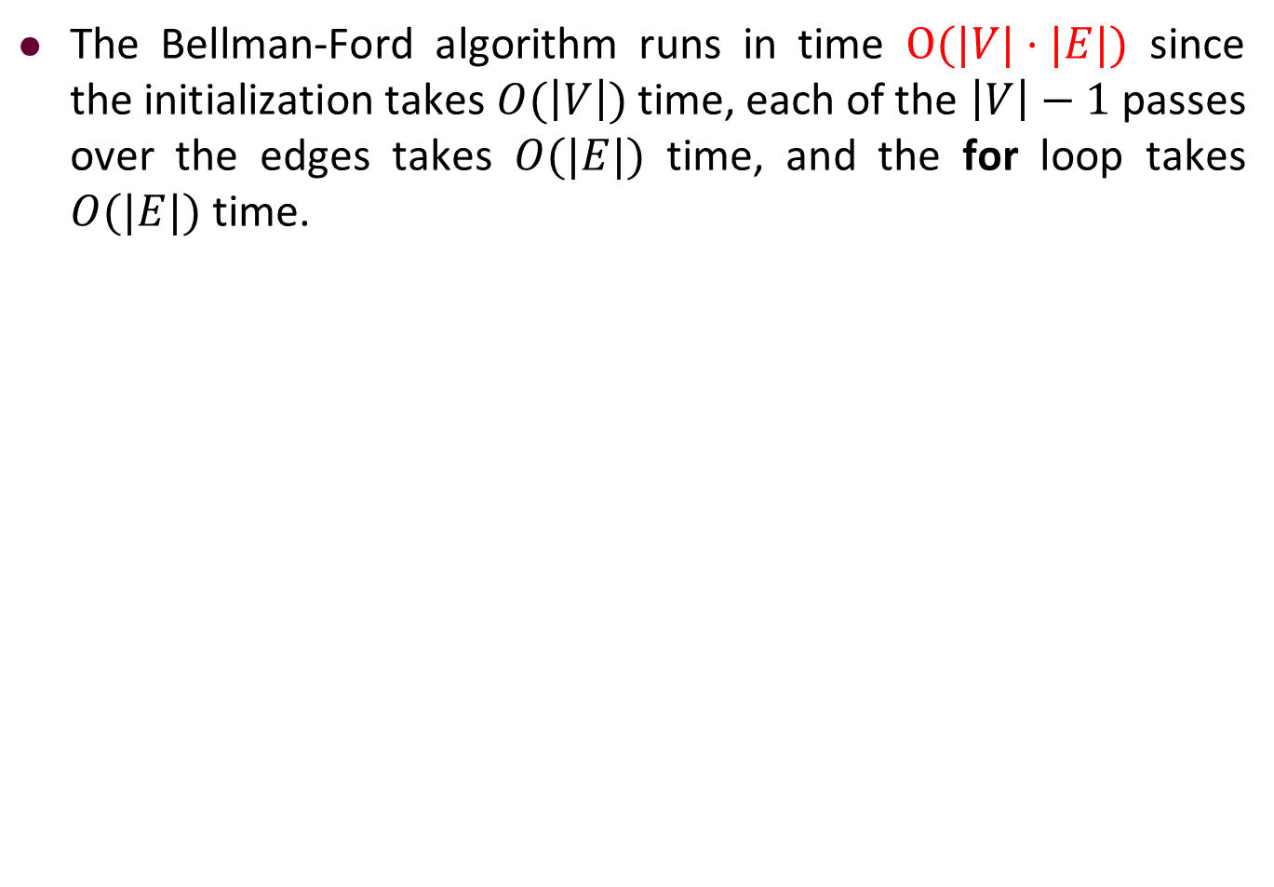
Analysis of Bellman-Ford Algorithm
The Bellman-Ford algorithm runs in time $O(|V|⋅|E|)$ since the initialization takes $O(\left|V\right|)$ time, each of the $\left|V\right|−1$ passes over the edges takes $O(|E|)$ time, and the for loop takes $O(|E|)$ time.

Slide 161



Analysis of Bellman-Ford Algorithm
The Bellman-Ford algorithm runs in time $O(|V|⋅|E|)$ since the initialization takes $O(\left|V\right|)$ time, each of the $\left|V\right|−1$ passes over the edges takes $O(|E|)$ time, and the for loop takes $O(|E|)$ time.
$$O(\left|V\right|)$$
$$O(\left|V\right|⋅|E|)$$
$$O(|E|)$$

Slide 162


